Slide 1

Family Friendly Pharmaceuticals:
Automatic Medication Dispenser

Slide 2
Members
XXX (Software)
YYY (Pusher Design and Animations)
ZZZ (Wiring and Hardware)
BBB (Base-plate and Pill Holder Design)

Slide 3
Problem and Solution

Slide 4
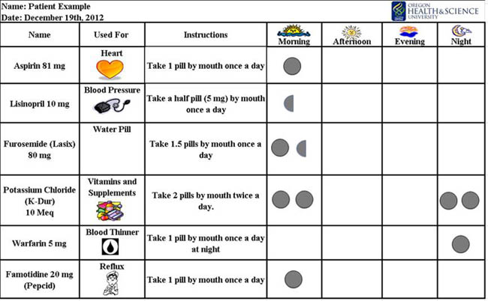

Problem:
Medications are often complicated and people can have a variety of them.
Medications may have differing schedules for when they must be taken by a patient.

Slide 5
Intended Solution:
For this project we chose to create an automated pill dispenser that would be capable of dispensing several types of medication at different times.
The goal of this project was to use two different types of medication, that each are controlled separately, and are dispensed based on a pre-timed program.

Slide 6
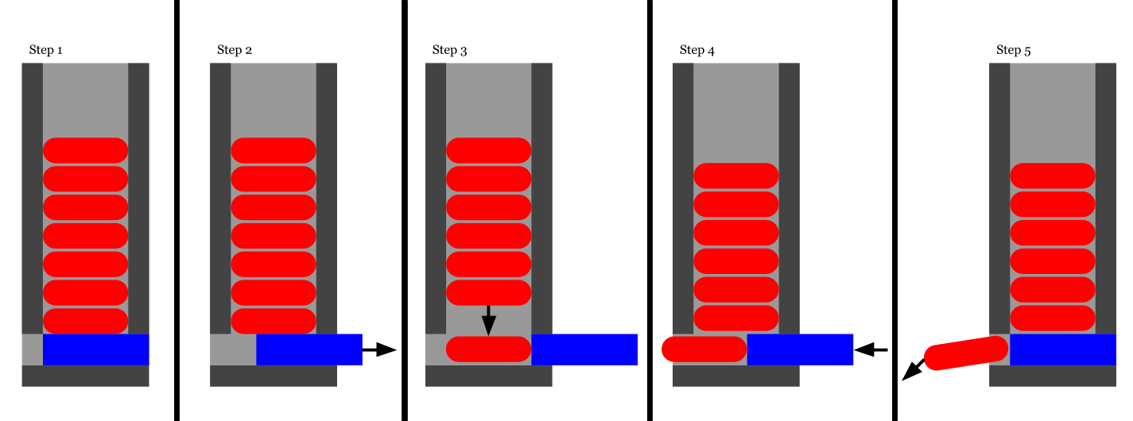
Dispenser Mechanism

Slide 7
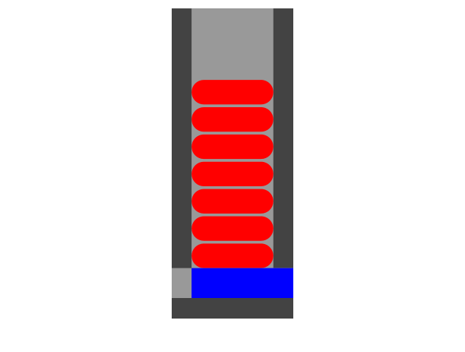
Notes:
I made 45 individual frames for this animation. It was not fun.
-Devin Ho

Slide 8
Design

Slide 9
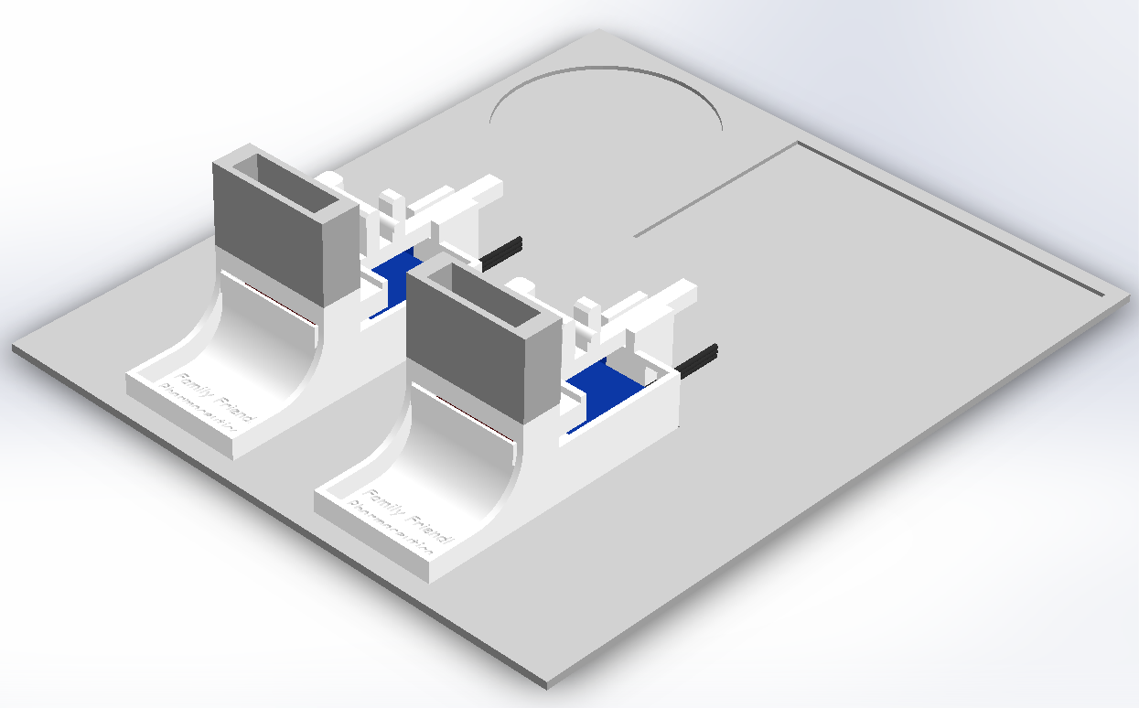
Full CAD Assembly

Slide 10
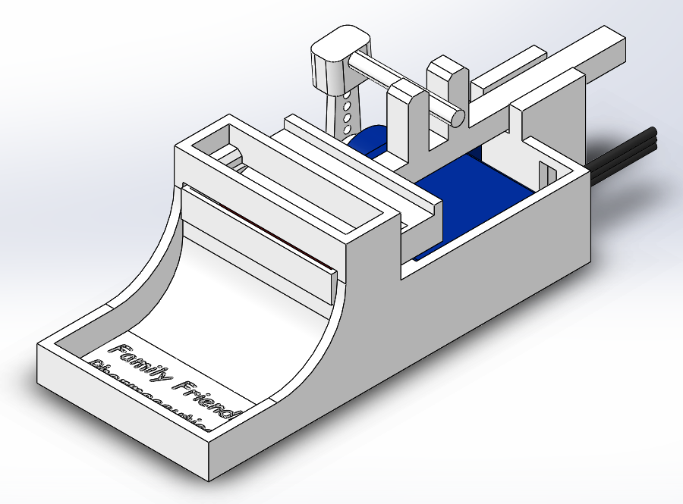
CAD Designs - Pusher

Slide 11
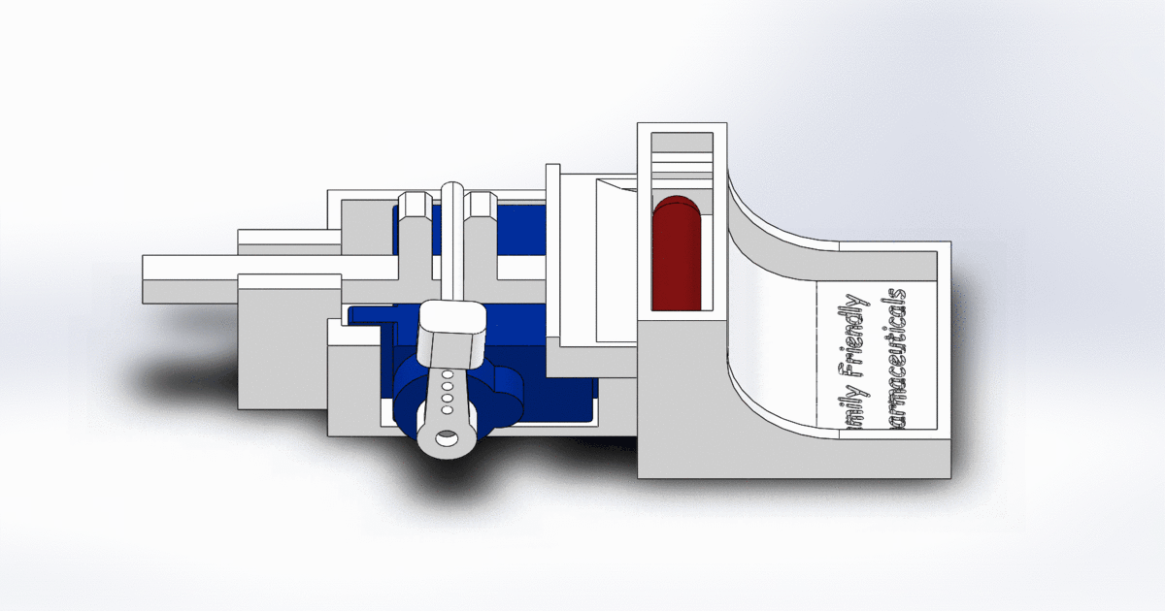
CAD Designs - Pusher Actuation

Slide 12
CAD Designs - Pusher Actuation (Slower)

Slide 13
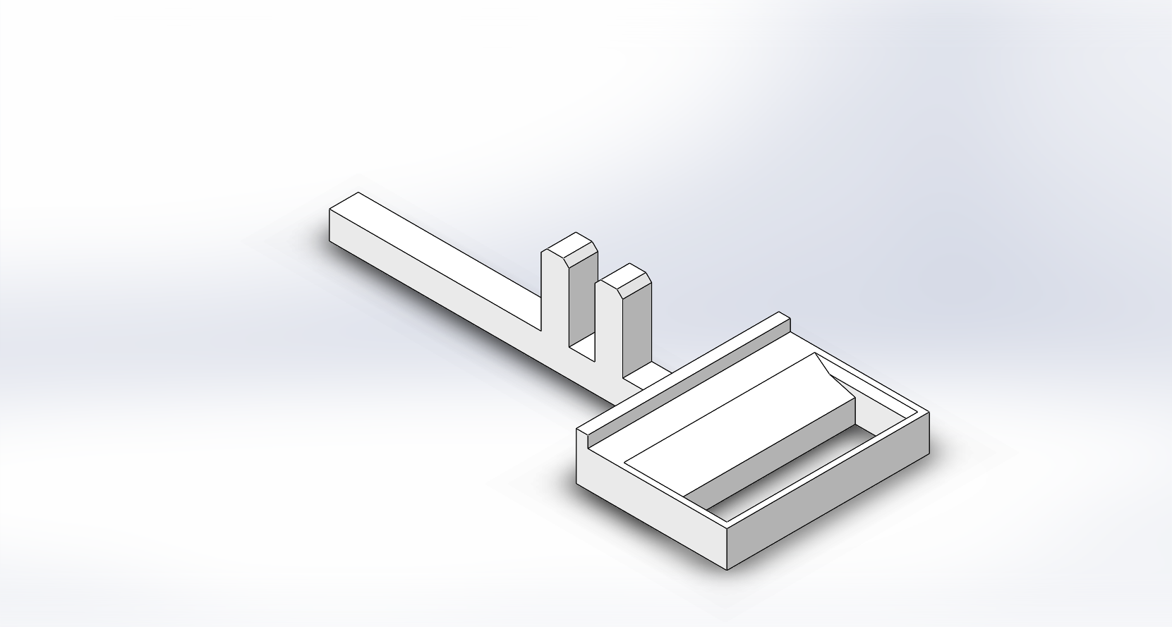
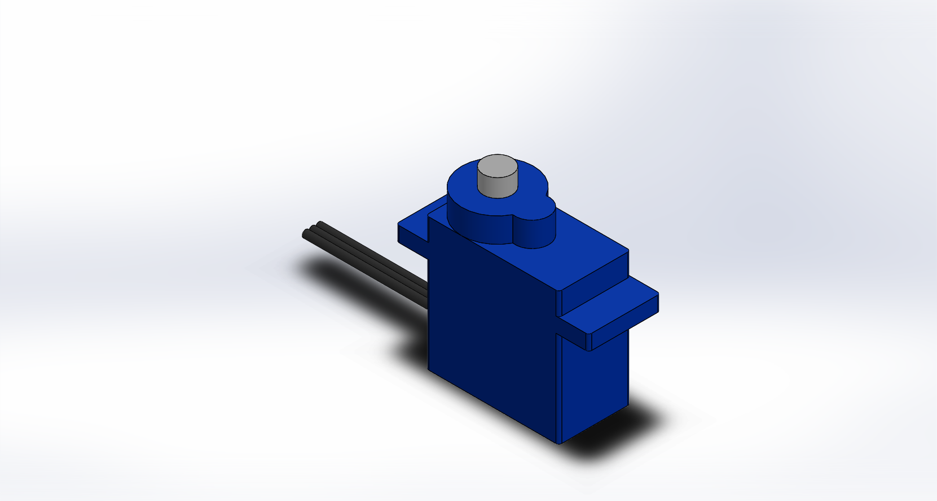
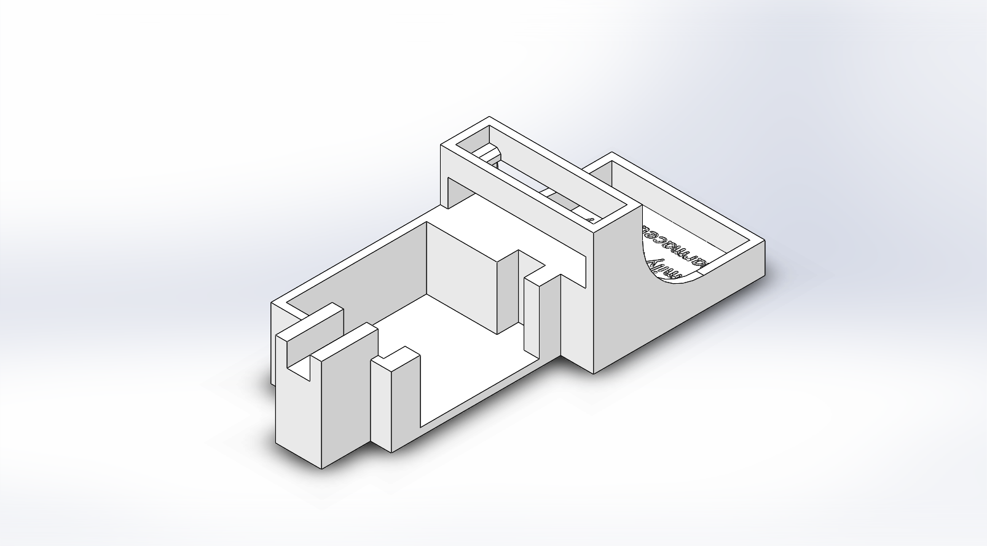
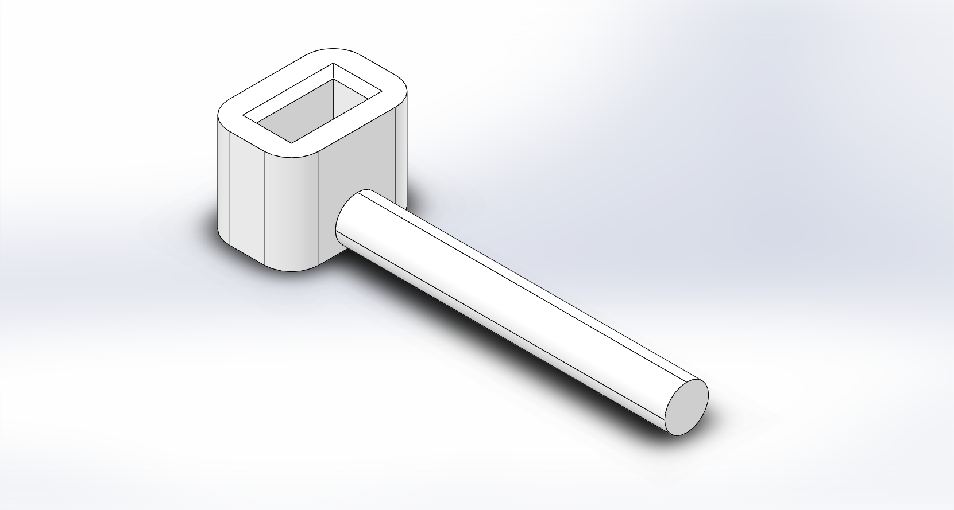
CAD Designs - Pusher
Notes:
Left to Right, Top to Bottom: Pusher Plate, Servo, Pusher Base, Force Transfer Rod

Slide 14
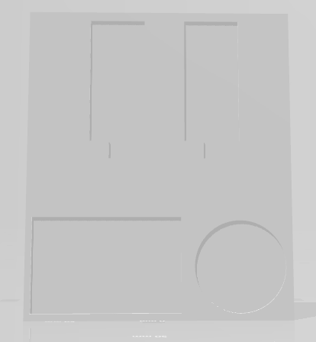
CAD Designs - Base Plate
Base Plate Dimensions: 179mm x 152mm x 2mm
Indentation Depth: 1mm
Arduino Indent Dimensions: 2 in diameter
Breadboard Dimensions: 85mm x 55mm
Pusher Dimensions Main Part: 70mm x 1.25 in
Pusher Dimensions Minor Part: 1mm x 1mm

Slide 15
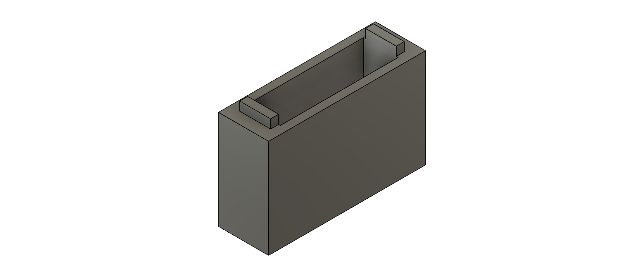
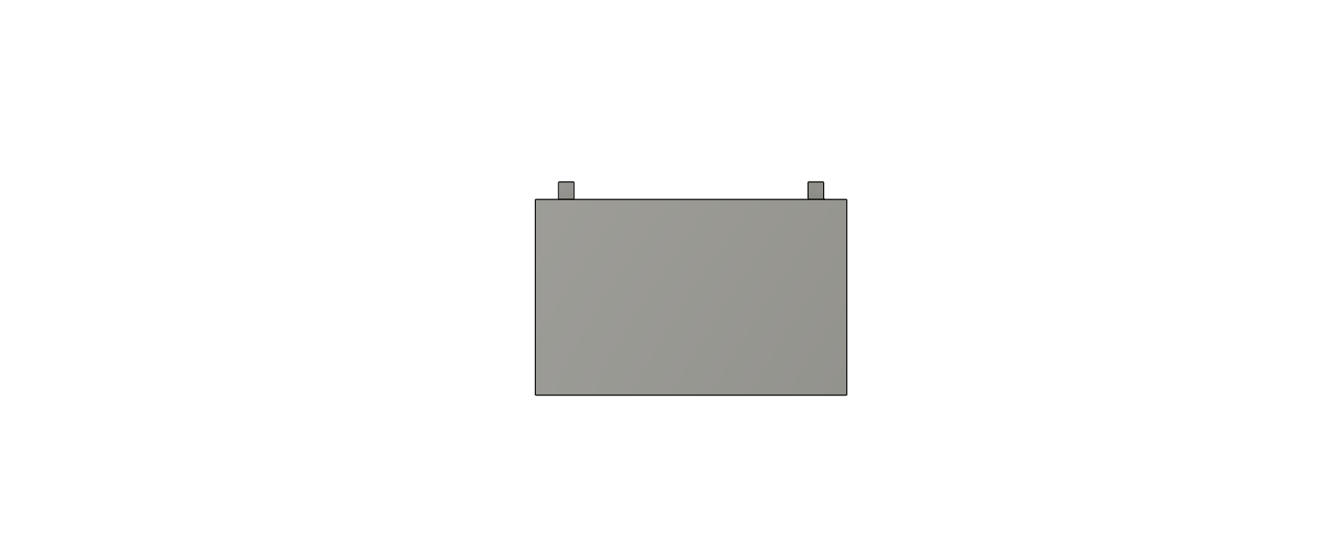
CAD Designs - Pill Holders
Height: 20mm
Depth: 10mm
Width: 30mm
Prong Length: 2mm

Slide 16
Final Assembly

Slide 17
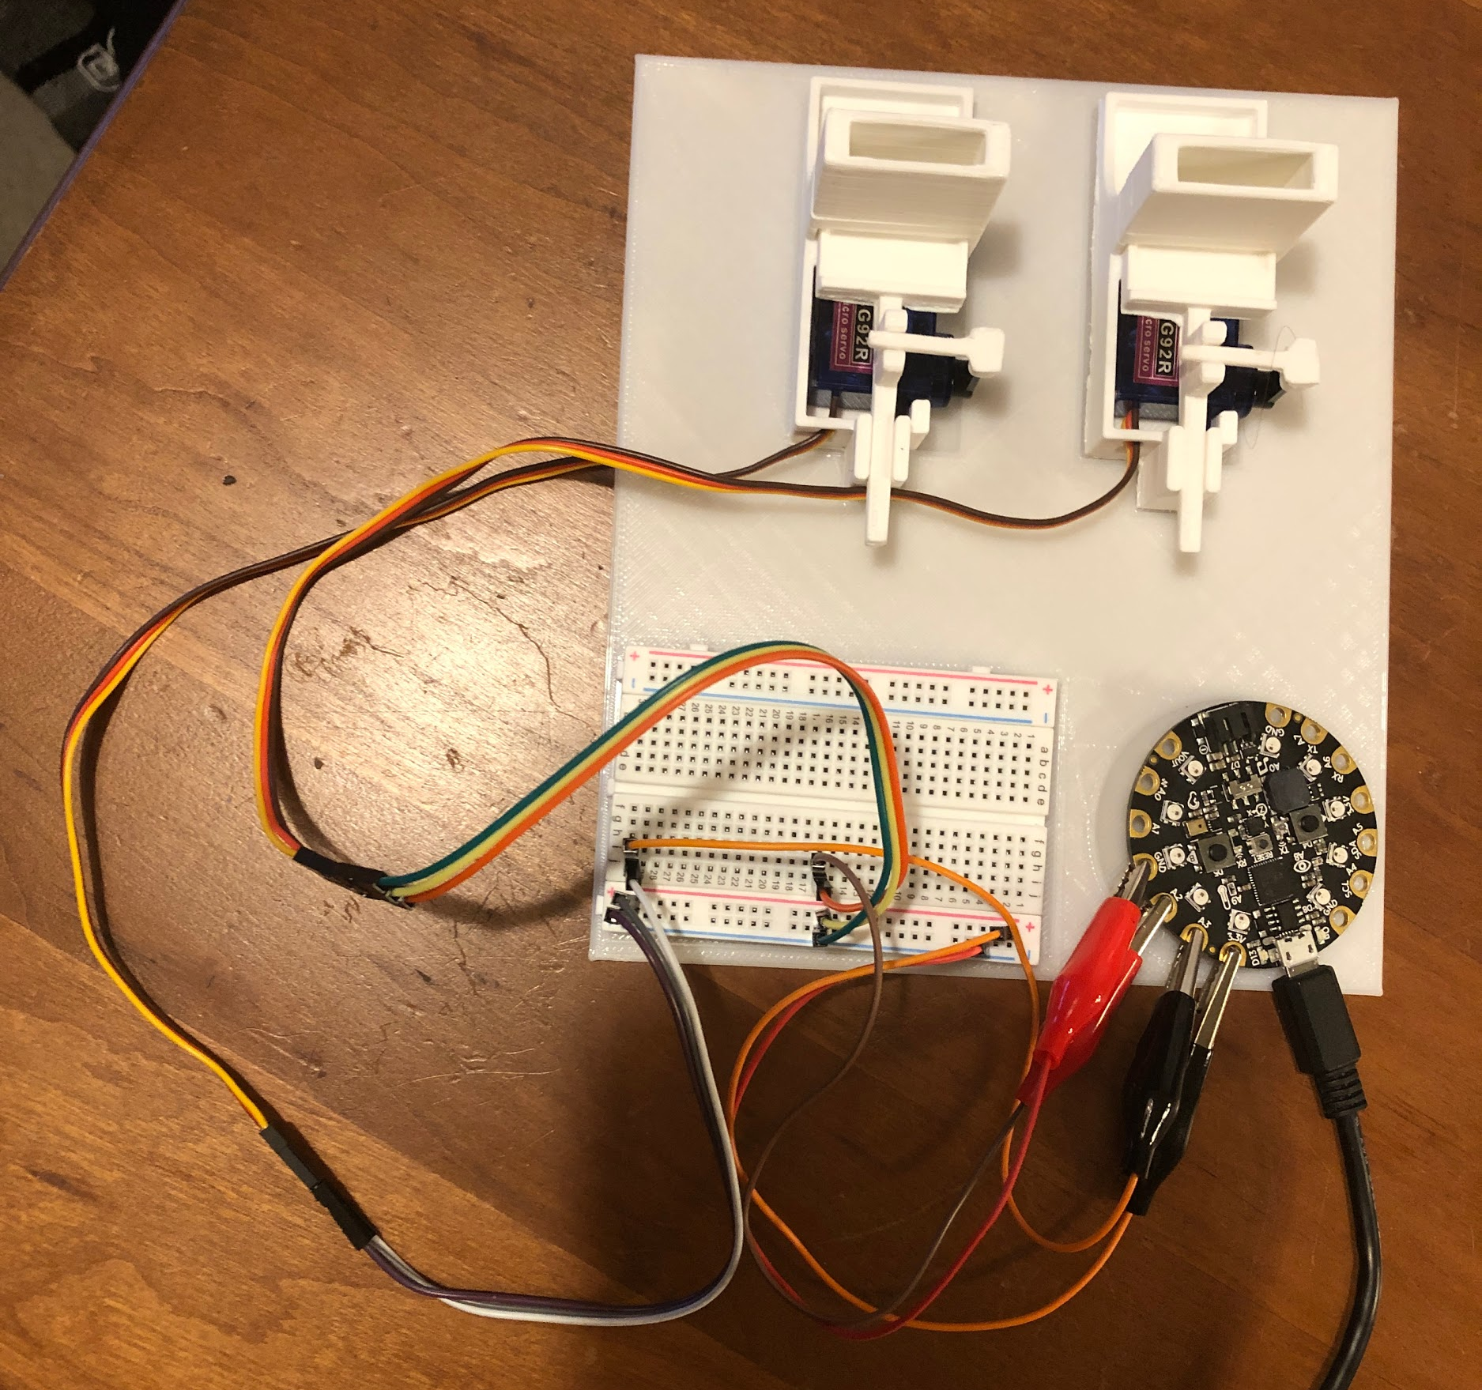
Finished Product Fully Assembled

Slide 18
Demo

Slide 19
Software Features in Demo
Features implemented & planned:
Controls rotation of servo to push & retract
(Timed Mode) Run scheduled pushes based on internal timer
(Timed Mode) Display progress bars using NeoPixels on the board
(Manual Mode) Use buttons to control pushes

Slide 20
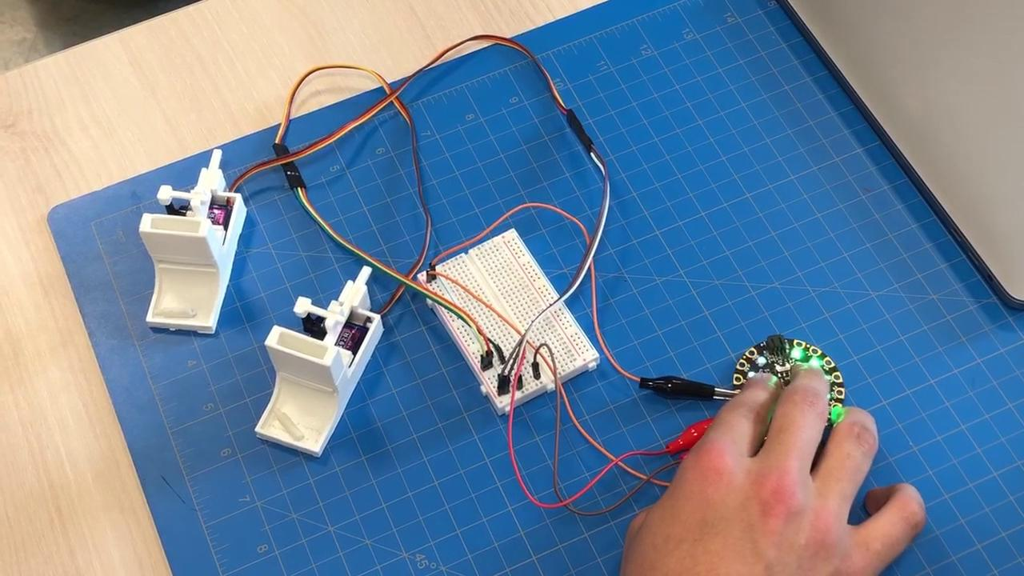
Finished Product (Manual Operation)

Slide 21
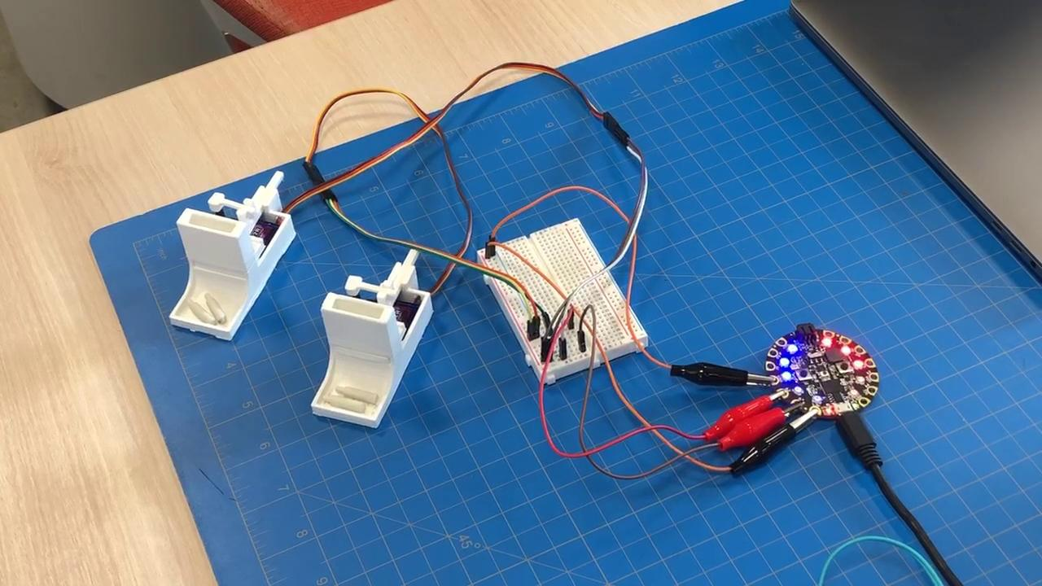
Finished Product (Timed Operation)

Slide 22
Software

Slide 23
def servoStartScheduledWait(servoObject):
waitTime = servoObject.getSchedule()[servoObject.getScheduleIndex()]
servoObject.incrementScheduleIndex()
return waitTime - (PUSH_WAIT + RETRACT_WAIT)
TASKS = [pushServo, retractServo, servoStartScheduledWait]
# Other functions
def pushServoA2():
time.sleep(pushServo(servoA2Object))
time.sleep(retractServo(servoA2Object))
def pushServoA3():
time.sleep(pushServo(servoA3Object))
time.sleep(retractServo(servoA3Object))
def retractServosWithoutWait():
servoA2.angle = INITIAL_ANGLE_A2
servoA3.angle = INITIAL_ANGLE_A3
def displayColors():
# Translate the gauges in the ServoObjects into NeoPixel values
for i in range(len(servoA2Object.getGreens())):
greens[4 - i] = servoA2Object.getGreens()[i]
reds[4 - i] = servoA2Object.getMyColors()[i]
greens[5 + i] = servoA3Object.getGreens()[i]
blues[5 + i] = servoA3Object.getMyColors()[i]
# Update NeoPixels and show them
for i in range(10):
pixels[i] = (reds[i], greens[i], blues[i])
pixels.show()
# Main loop
while True:
# Update from switch
motionIsOn = not switch.value
# Main business logic
if motionIsOn:
displayColors()
servoA2Object.updateTime()
servoA3Object.updateTime()
elif buttonD4.value:
# Show green color
servoA2Object.gaugeGreen = [100, 100, 100, 100, 100]
servoA2Object.gaugeMyColor = [0, 0, 0, 0, 0]
displayColors()
# Push servo A2
pushServoA2()
elif buttonD5.value:
# Show green color
servoA3Object.gaugeGreen = [100, 100, 100, 100, 100]
servoA3Object.gaugeMyColor = [0, 0, 0, 0, 0]
displayColors()
# Push servo A3
pushServoA3()
else:
# Return to default colors
servoA2Object.gaugeGreen = [10, 10, 10, 10, 10]
servoA3Object.gaugeGreen = [10, 10, 10, 10, 10]
servoA2Object.gaugeMyColor = [10, 10, 10, 10, 10]
servoA3Object.gaugeMyColor = [10, 10, 10, 10, 10]
displayColors()
# Retract servos
retractServosWithoutWait()
# Wait
time.sleep(REFRESH_DURATION)
elif TASKS[self.currentTask] is servoStartScheduledWait:
# Actual current task = retractServo
for i in range(len(self.gaugeGreen)):
progress = self.currentTaskMaxDuration - self.currentTaskRemainingDuration
if progress > i * self.currentTaskMaxDuration / 5:
self.gaugeGreen[4 - i] = 0
self.gaugeMyColor[4 - i] = 10
else:
self.gaugeGreen[4 - i] = 100
self.gaugeMyColor[4 - i] = 0
if self.currentTaskRemainingDuration <= 0:
self.runNextTask()
# SETTERS
def incrementScheduleIndex(self):
self.scheduleIndex += 1
if self.scheduleIndex >= len(self.schedule):
self.scheduleIndex = 0
# GETTERS
def getSchedule(self): return self.schedule
def getScheduleIndex(self): return self.scheduleIndex
def getGreens(self): return self.gaugeGreen
def getMyColors(self): return self.gaugeMyColor
servoA2Object = ServoObject(servoA2, SERVO_A2_SCHEDULE, INITIAL_ANGLE_A2)
servoA3Object = ServoObject(servoA3, SERVO_A3_SCHEDULE, INITIAL_ANGLE_A3)
# Setup
reds = [10,10,10,10,255,0,0,0,0,0]
greens = [0,0,0,0,0,0,0,0,0,0]
blues = [0,0,0,0,0,255,10,10,10,10]
servoA2.angle = INITIAL_ANGLE_A2
servoA3.angle = INITIAL_ANGLE_A3
# Tasks
# - Return values: countdown duration of each task
def pushServo(servoObject):
servoObject.servo.angle = servoObject.initialAngle + SERVO_SPAN
return PUSH_WAIT
def retractServo(servoObject):
servoObject.servo.angle = servoObject.initialAngle
return RETRACT_WAIT
def servoStartScheduledWait(servoObject):
waitTime = servoObject.getSchedule()[servoObject.getScheduleIndex()]
servoObject.incrementScheduleIndex()
return waitTime - (PUSH_WAIT + RETRACT_WAIT)
TASKS = [pushServo, retractServo, servoStartScheduledWait]
# Other functions
def pushServoA2():
time.sleep(pushServo(servoA2Object))
time.sleep(retractServo(servoA2Object))
def pushServoA3():
time.sleep(pushServo(servoA3Object))
time.sleep(retractServo(servoA3Object))
def retractServosWithoutWait():
servoA2.angle = INITIAL_ANGLE_A2
servoA3.angle = INITIAL_ANGLE_A3
# Classes
class ServoObject:
def __init__(self, servo, schedule, initialAngle):
self.servo = servo
self.schedule = schedule
self.initialAngle = initialAngle
self.currentTask = 0
self.currentTaskRemainingDuration = 0
self.currentTaskMaxDuration = 0
self.scheduleIndex = 0
self.gaugeGreen = [0,0,0,0,0]
self.gaugeMyColor = [255,10,10,10,10]
def startNextTaskCountdown(self, duration):
self.currentTask += 1
if (self.currentTask >= len(TASKS)):
self.currentTask = 0
self.currentTaskRemainingDuration = duration
self.currentTaskMaxDuration = duration
def runNextTask(self):
# TASKS MUST RETURN COUNTDOWN DURATION
self.startNextTaskCountdown(TASKS[self.currentTask](self))
def updateTime(self):
self.currentTaskRemainingDuration -= REFRESH_DURATION
if TASKS[self.currentTask] is pushServo:
# Actual current task = servoStartScheduledWait
for i in range(len(self.gaugeMyColor)):
self.gaugeGreen[i] = 0
progress = self.currentTaskMaxDuration - self.currentTaskRemainingDuration
if progress > i * self.currentTaskMaxDuration / 5:
self.gaugeMyColor[i] = 255
else:
self.gaugeMyColor[i] = 10
elif TASKS[self.currentTask] is retractServo:
# Actual current task = pushServo
for i in range(len(self.gaugeGreen)):
progress = self.currentTaskMaxDuration - self.currentTaskRemainingDuration
if progress > i * self.currentTaskMaxDuration / 5:
self.gaugeGreen[i] = 100
self.gaugeMyColor[i] = 0
else:
self.gaugeGreen[i] = 0
self.gaugeMyColor[i] = 10
elif TASKS[self.currentTask] is servoStartScheduledWait:
# Actual current task = retractServo
for i in range(len(self.gaugeGreen)):
progress = self.currentTaskMaxDuration - self.currentTaskRemainingDuration
if progress > i * self.currentTaskMaxDuration / 5:
self.gaugeGreen[4 - i] = 0
self.gaugeMyColor[4 - i] = 10
else:
self.gaugeGreen[4 - i] = 100
self.gaugeMyColor[4 - i] = 0
if self.currentTaskRemainingDuration <= 0:
self.runNextTask()
# SETTERS
def incrementScheduleIndex(self):
self.scheduleIndex += 1
if self.scheduleIndex >= len(self.schedule):
self.scheduleIndex = 0
# GETTERS
def getSchedule(self): return self.schedule
def getScheduleIndex(self): return self.scheduleIndex
def getGreens(self): return self.gaugeGreen
def getMyColors(self): return self.gaugeMyColor
import time
import random
import digitalio
import pulseio
import board
import neopixel
import adafruit_motor.servo
# Hardware Setup
pixels = neopixel.NeoPixel(board.NEOPIXEL, 10, brightness=0.2, auto_write=False)
led = digitalio.DigitalInOut(board.D13)
led.direction = digitalio.Direction.OUTPUT
led.value = True
switch = digitalio.DigitalInOut(board.D7)
switch.direction = digitalio.Direction.INPUT
switch.pull = digitalio.Pull.UP
buttonD4 = digitalio.DigitalInOut(board.D4)
buttonD5 = digitalio.DigitalInOut(board.D5)
buttonD4.direction = digitalio.Direction.INPUT
buttonD5.direction = digitalio.Direction.INPUT
buttonD4.pull = digitalio.Pull.DOWN
buttonD5.pull = digitalio.Pull.DOWN
servoA2 = adafruit_motor.servo.Servo(pulseio.PWMOut(board.A2, frequency=50), min_pul
servoA3 = adafruit_motor.servo.Servo(pulseio.PWMOut(board.A3, frequency=50), min_pul
# CONSTANTS - User designated
SERVO_A2_SCHEDULE = [3, 6, 9] # Delta time schedule for servo A2, in seconds
SERVO_A3_SCHEDULE = [4, 2, 2, 8] # Delta time schedule for servo A3, in seconds
# CONSTANTS - Technical
INITIAL_ANGLE_A2 = 164
INITIAL_ANGLE_A3 = 114
SERVO_SPAN = -30 # How much the servos should turn (degrees)
PUSH_WAIT = 0.25 # Wait time after initating a servo push command
RETRACT_WAIT = 1.0 # Wait time after initiating a servo retract command
REFRESH_DURATION = 0.05 # Wait time between each update
# Classes
class ServoObject:
def __init__(self, servo, schedule, initialAngle):
self.servo = servo
self.schedule = schedule
self.initialAngle = initialAngle
self.currentTask = 0
self.currentTaskRemainingDuration = 0
self.currentTaskMaxDuration = 0
self.scheduleIndex = 0
self.gaugeGreen = [0,0,0,0,0]
self.gaugeMyColor = [255,10,10,10,10]

Slide 24
def servoStartScheduledWait(servoObject):
waitTime = servoObject.getSchedule()[servoObject.getScheduleIndex()]
servoObject.incrementScheduleIndex()
return waitTime - (PUSH_WAIT + RETRACT_WAIT)
TASKS = [pushServo, retractServo, servoStartScheduledWait]
# Other functions
def pushServoA2():
time.sleep(pushServo(servoA2Object))
time.sleep(retractServo(servoA2Object))
def pushServoA3():
time.sleep(pushServo(servoA3Object))
time.sleep(retractServo(servoA3Object))
def retractServosWithoutWait():
servoA2.angle = INITIAL_ANGLE_A2
servoA3.angle = INITIAL_ANGLE_A3
def displayColors():
# Translate the gauges in the ServoObjects into NeoPixel values
for i in range(len(servoA2Object.getGreens())):
greens[4 - i] = servoA2Object.getGreens()[i]
reds[4 - i] = servoA2Object.getMyColors()[i]
greens[5 + i] = servoA3Object.getGreens()[i]
blues[5 + i] = servoA3Object.getMyColors()[i]
# Update NeoPixels and show them
for i in range(10):
pixels[i] = (reds[i], greens[i], blues[i])
pixels.show()
# Main loop
while True:
# Update from switch
motionIsOn = not switch.value
# Main business logic
if motionIsOn:
displayColors()
servoA2Object.updateTime()
servoA3Object.updateTime()
elif buttonD4.value:
# Show green color
servoA2Object.gaugeGreen = [100, 100, 100, 100, 100]
servoA2Object.gaugeMyColor = [0, 0, 0, 0, 0]
displayColors()
# Push servo A2
pushServoA2()
elif buttonD5.value:
# Show green color
servoA3Object.gaugeGreen = [100, 100, 100, 100, 100]
servoA3Object.gaugeMyColor = [0, 0, 0, 0, 0]
displayColors()
# Push servo A3
pushServoA3()
else:
# Return to default colors
servoA2Object.gaugeGreen = [10, 10, 10, 10, 10]
servoA3Object.gaugeGreen = [10, 10, 10, 10, 10]
servoA2Object.gaugeMyColor = [10, 10, 10, 10, 10]
servoA3Object.gaugeMyColor = [10, 10, 10, 10, 10]
displayColors()
# Retract servos
retractServosWithoutWait()
# Wait
time.sleep(REFRESH_DURATION)
elif TASKS[self.currentTask] is servoStartScheduledWait:
# Actual current task = retractServo
for i in range(len(self.gaugeGreen)):
progress = self.currentTaskMaxDuration - self.currentTaskRemainingDuration
if progress > i * self.currentTaskMaxDuration / 5:
self.gaugeGreen[4 - i] = 0
self.gaugeMyColor[4 - i] = 10
else:
self.gaugeGreen[4 - i] = 100
self.gaugeMyColor[4 - i] = 0
if self.currentTaskRemainingDuration <= 0:
self.runNextTask()
# SETTERS
def incrementScheduleIndex(self):
self.scheduleIndex += 1
if self.scheduleIndex >= len(self.schedule):
self.scheduleIndex = 0
# GETTERS
def getSchedule(self): return self.schedule
def getScheduleIndex(self): return self.scheduleIndex
def getGreens(self): return self.gaugeGreen
def getMyColors(self): return self.gaugeMyColor
servoA2Object = ServoObject(servoA2, SERVO_A2_SCHEDULE, INITIAL_ANGLE_A2)
servoA3Object = ServoObject(servoA3, SERVO_A3_SCHEDULE, INITIAL_ANGLE_A3)
# Setup
reds = [10,10,10,10,255,0,0,0,0,0]
greens = [0,0,0,0,0,0,0,0,0,0]
blues = [0,0,0,0,0,255,10,10,10,10]
servoA2.angle = INITIAL_ANGLE_A2
servoA3.angle = INITIAL_ANGLE_A3
# Tasks
# - Return values: countdown duration of each task
def pushServo(servoObject):
servoObject.servo.angle = servoObject.initialAngle + SERVO_SPAN
return PUSH_WAIT
def retractServo(servoObject):
servoObject.servo.angle = servoObject.initialAngle
return RETRACT_WAIT
def servoStartScheduledWait(servoObject):
waitTime = servoObject.getSchedule()[servoObject.getScheduleIndex()]
servoObject.incrementScheduleIndex()
return waitTime - (PUSH_WAIT + RETRACT_WAIT)
TASKS = [pushServo, retractServo, servoStartScheduledWait]
# Other functions
def pushServoA2():
time.sleep(pushServo(servoA2Object))
time.sleep(retractServo(servoA2Object))
def pushServoA3():
time.sleep(pushServo(servoA3Object))
time.sleep(retractServo(servoA3Object))
def retractServosWithoutWait():
servoA2.angle = INITIAL_ANGLE_A2
servoA3.angle = INITIAL_ANGLE_A3
# Classes
class ServoObject:
def __init__(self, servo, schedule, initialAngle):
self.servo = servo
self.schedule = schedule
self.initialAngle = initialAngle
self.currentTask = 0
self.currentTaskRemainingDuration = 0
self.currentTaskMaxDuration = 0
self.scheduleIndex = 0
self.gaugeGreen = [0,0,0,0,0]
self.gaugeMyColor = [255,10,10,10,10]
def startNextTaskCountdown(self, duration):
self.currentTask += 1
if (self.currentTask >= len(TASKS)):
self.currentTask = 0
self.currentTaskRemainingDuration = duration
self.currentTaskMaxDuration = duration
def runNextTask(self):
# TASKS MUST RETURN COUNTDOWN DURATION
self.startNextTaskCountdown(TASKS[self.currentTask](self))
def updateTime(self):
self.currentTaskRemainingDuration -= REFRESH_DURATION
if TASKS[self.currentTask] is pushServo:
# Actual current task = servoStartScheduledWait
for i in range(len(self.gaugeMyColor)):
self.gaugeGreen[i] = 0
progress = self.currentTaskMaxDuration - self.currentTaskRemainingDuration
if progress > i * self.currentTaskMaxDuration / 5:
self.gaugeMyColor[i] = 255
else:
self.gaugeMyColor[i] = 10
elif TASKS[self.currentTask] is retractServo:
# Actual current task = pushServo
for i in range(len(self.gaugeGreen)):
progress = self.currentTaskMaxDuration - self.currentTaskRemainingDuration
if progress > i * self.currentTaskMaxDuration / 5:
self.gaugeGreen[i] = 100
self.gaugeMyColor[i] = 0
else:
self.gaugeGreen[i] = 0
self.gaugeMyColor[i] = 10
elif TASKS[self.currentTask] is servoStartScheduledWait:
# Actual current task = retractServo
for i in range(len(self.gaugeGreen)):
progress = self.currentTaskMaxDuration - self.currentTaskRemainingDuration
if progress > i * self.currentTaskMaxDuration / 5:
self.gaugeGreen[4 - i] = 0
self.gaugeMyColor[4 - i] = 10
else:
self.gaugeGreen[4 - i] = 100
self.gaugeMyColor[4 - i] = 0
if self.currentTaskRemainingDuration <= 0:
self.runNextTask()
# SETTERS
def incrementScheduleIndex(self):
self.scheduleIndex += 1
if self.scheduleIndex >= len(self.schedule):
self.scheduleIndex = 0
# GETTERS
def getSchedule(self): return self.schedule
def getScheduleIndex(self): return self.scheduleIndex
def getGreens(self): return self.gaugeGreen
def getMyColors(self): return self.gaugeMyColor
import time
import random
import digitalio
import pulseio
import board
import neopixel
import adafruit_motor.servo
# Hardware Setup
pixels = neopixel.NeoPixel(board.NEOPIXEL, 10, brightness=0.2, auto_write=False)
led = digitalio.DigitalInOut(board.D13)
led.direction = digitalio.Direction.OUTPUT
led.value = True
switch = digitalio.DigitalInOut(board.D7)
switch.direction = digitalio.Direction.INPUT
switch.pull = digitalio.Pull.UP
buttonD4 = digitalio.DigitalInOut(board.D4)
buttonD5 = digitalio.DigitalInOut(board.D5)
buttonD4.direction = digitalio.Direction.INPUT
buttonD5.direction = digitalio.Direction.INPUT
buttonD4.pull = digitalio.Pull.DOWN
buttonD5.pull = digitalio.Pull.DOWN
servoA2 = adafruit_motor.servo.Servo(pulseio.PWMOut(board.A2, frequency=50), min_pul
servoA3 = adafruit_motor.servo.Servo(pulseio.PWMOut(board.A3, frequency=50), min_pul
# CONSTANTS - User designated
SERVO_A2_SCHEDULE = [3, 6, 9] # Delta time schedule for servo A2, in seconds
SERVO_A3_SCHEDULE = [4, 2, 2, 8] # Delta time schedule for servo A3, in seconds
# CONSTANTS - Technical
INITIAL_ANGLE_A2 = 164
INITIAL_ANGLE_A3 = 114
SERVO_SPAN = -30 # How much the servos should turn (degrees)
PUSH_WAIT = 0.25 # Wait time after initating a servo push command
RETRACT_WAIT = 1.0 # Wait time after initiating a servo retract command
REFRESH_DURATION = 0.05 # Wait time between each update
# Classes
class ServoObject:
def __init__(self, servo, schedule, initialAngle):
self.servo = servo
self.schedule = schedule
self.initialAngle = initialAngle
self.currentTask = 0
self.currentTaskRemainingDuration = 0
self.currentTaskMaxDuration = 0
self.scheduleIndex = 0
self.gaugeGreen = [0,0,0,0,0]
self.gaugeMyColor = [255,10,10,10,10]
Main while loop

Slide 25
def servoStartScheduledWait(servoObject):
waitTime = servoObject.getSchedule()[servoObject.getScheduleIndex()]
servoObject.incrementScheduleIndex()
return waitTime - (PUSH_WAIT + RETRACT_WAIT)
TASKS = [pushServo, retractServo, servoStartScheduledWait]
# Other functions
def pushServoA2():
time.sleep(pushServo(servoA2Object))
time.sleep(retractServo(servoA2Object))
def pushServoA3():
time.sleep(pushServo(servoA3Object))
time.sleep(retractServo(servoA3Object))
def retractServosWithoutWait():
servoA2.angle = INITIAL_ANGLE_A2
servoA3.angle = INITIAL_ANGLE_A3
def displayColors():
# Translate the gauges in the ServoObjects into NeoPixel values
for i in range(len(servoA2Object.getGreens())):
greens[4 - i] = servoA2Object.getGreens()[i]
reds[4 - i] = servoA2Object.getMyColors()[i]
greens[5 + i] = servoA3Object.getGreens()[i]
blues[5 + i] = servoA3Object.getMyColors()[i]
# Update NeoPixels and show them
for i in range(10):
pixels[i] = (reds[i], greens[i], blues[i])
pixels.show()
# Main loop
while True:
# Update from switch
motionIsOn = not switch.value
# Main business logic
if motionIsOn:
displayColors()
servoA2Object.updateTime()
servoA3Object.updateTime()
elif buttonD4.value:
# Show green color
servoA2Object.gaugeGreen = [100, 100, 100, 100, 100]
servoA2Object.gaugeMyColor = [0, 0, 0, 0, 0]
displayColors()
# Push servo A2
pushServoA2()
elif buttonD5.value:
# Show green color
servoA3Object.gaugeGreen = [100, 100, 100, 100, 100]
servoA3Object.gaugeMyColor = [0, 0, 0, 0, 0]
displayColors()
# Push servo A3
pushServoA3()
else:
# Return to default colors
servoA2Object.gaugeGreen = [10, 10, 10, 10, 10]
servoA3Object.gaugeGreen = [10, 10, 10, 10, 10]
servoA2Object.gaugeMyColor = [10, 10, 10, 10, 10]
servoA3Object.gaugeMyColor = [10, 10, 10, 10, 10]
displayColors()
# Retract servos
retractServosWithoutWait()
# Wait
time.sleep(REFRESH_DURATION)
elif TASKS[self.currentTask] is servoStartScheduledWait:
# Actual current task = retractServo
for i in range(len(self.gaugeGreen)):
progress = self.currentTaskMaxDuration - self.currentTaskRemainingDuration
if progress > i * self.currentTaskMaxDuration / 5:
self.gaugeGreen[4 - i] = 0
self.gaugeMyColor[4 - i] = 10
else:
self.gaugeGreen[4 - i] = 100
self.gaugeMyColor[4 - i] = 0
if self.currentTaskRemainingDuration <= 0:
self.runNextTask()
# SETTERS
def incrementScheduleIndex(self):
self.scheduleIndex += 1
if self.scheduleIndex >= len(self.schedule):
self.scheduleIndex = 0
# GETTERS
def getSchedule(self): return self.schedule
def getScheduleIndex(self): return self.scheduleIndex
def getGreens(self): return self.gaugeGreen
def getMyColors(self): return self.gaugeMyColor
servoA2Object = ServoObject(servoA2, SERVO_A2_SCHEDULE, INITIAL_ANGLE_A2)
servoA3Object = ServoObject(servoA3, SERVO_A3_SCHEDULE, INITIAL_ANGLE_A3)
# Setup
reds = [10,10,10,10,255,0,0,0,0,0]
greens = [0,0,0,0,0,0,0,0,0,0]
blues = [0,0,0,0,0,255,10,10,10,10]
servoA2.angle = INITIAL_ANGLE_A2
servoA3.angle = INITIAL_ANGLE_A3
# Tasks
# - Return values: countdown duration of each task
def pushServo(servoObject):
servoObject.servo.angle = servoObject.initialAngle + SERVO_SPAN
return PUSH_WAIT
def retractServo(servoObject):
servoObject.servo.angle = servoObject.initialAngle
return RETRACT_WAIT
def servoStartScheduledWait(servoObject):
waitTime = servoObject.getSchedule()[servoObject.getScheduleIndex()]
servoObject.incrementScheduleIndex()
return waitTime - (PUSH_WAIT + RETRACT_WAIT)
TASKS = [pushServo, retractServo, servoStartScheduledWait]
# Other functions
def pushServoA2():
time.sleep(pushServo(servoA2Object))
time.sleep(retractServo(servoA2Object))
def pushServoA3():
time.sleep(pushServo(servoA3Object))
time.sleep(retractServo(servoA3Object))
def retractServosWithoutWait():
servoA2.angle = INITIAL_ANGLE_A2
servoA3.angle = INITIAL_ANGLE_A3
# Classes
class ServoObject:
def __init__(self, servo, schedule, initialAngle):
self.servo = servo
self.schedule = schedule
self.initialAngle = initialAngle
self.currentTask = 0
self.currentTaskRemainingDuration = 0
self.currentTaskMaxDuration = 0
self.scheduleIndex = 0
self.gaugeGreen = [0,0,0,0,0]
self.gaugeMyColor = [255,10,10,10,10]
def startNextTaskCountdown(self, duration):
self.currentTask += 1
if (self.currentTask >= len(TASKS)):
self.currentTask = 0
self.currentTaskRemainingDuration = duration
self.currentTaskMaxDuration = duration
def runNextTask(self):
# TASKS MUST RETURN COUNTDOWN DURATION
self.startNextTaskCountdown(TASKS[self.currentTask](self))
def updateTime(self):
self.currentTaskRemainingDuration -= REFRESH_DURATION
if TASKS[self.currentTask] is pushServo:
# Actual current task = servoStartScheduledWait
for i in range(len(self.gaugeMyColor)):
self.gaugeGreen[i] = 0
progress = self.currentTaskMaxDuration - self.currentTaskRemainingDuration
if progress > i * self.currentTaskMaxDuration / 5:
self.gaugeMyColor[i] = 255
else:
self.gaugeMyColor[i] = 10
elif TASKS[self.currentTask] is retractServo:
# Actual current task = pushServo
for i in range(len(self.gaugeGreen)):
progress = self.currentTaskMaxDuration - self.currentTaskRemainingDuration
if progress > i * self.currentTaskMaxDuration / 5:
self.gaugeGreen[i] = 100
self.gaugeMyColor[i] = 0
else:
self.gaugeGreen[i] = 0
self.gaugeMyColor[i] = 10
elif TASKS[self.currentTask] is servoStartScheduledWait:
# Actual current task = retractServo
for i in range(len(self.gaugeGreen)):
progress = self.currentTaskMaxDuration - self.currentTaskRemainingDuration
if progress > i * self.currentTaskMaxDuration / 5:
self.gaugeGreen[4 - i] = 0
self.gaugeMyColor[4 - i] = 10
else:
self.gaugeGreen[4 - i] = 100
self.gaugeMyColor[4 - i] = 0
if self.currentTaskRemainingDuration <= 0:
self.runNextTask()
# SETTERS
def incrementScheduleIndex(self):
self.scheduleIndex += 1
if self.scheduleIndex >= len(self.schedule):
self.scheduleIndex = 0
# GETTERS
def getSchedule(self): return self.schedule
def getScheduleIndex(self): return self.scheduleIndex
def getGreens(self): return self.gaugeGreen
def getMyColors(self): return self.gaugeMyColor
import time
import random
import digitalio
import pulseio
import board
import neopixel
import adafruit_motor.servo
# Hardware Setup
pixels = neopixel.NeoPixel(board.NEOPIXEL, 10, brightness=0.2, auto_write=False)
led = digitalio.DigitalInOut(board.D13)
led.direction = digitalio.Direction.OUTPUT
led.value = True
switch = digitalio.DigitalInOut(board.D7)
switch.direction = digitalio.Direction.INPUT
switch.pull = digitalio.Pull.UP
buttonD4 = digitalio.DigitalInOut(board.D4)
buttonD5 = digitalio.DigitalInOut(board.D5)
buttonD4.direction = digitalio.Direction.INPUT
buttonD5.direction = digitalio.Direction.INPUT
buttonD4.pull = digitalio.Pull.DOWN
buttonD5.pull = digitalio.Pull.DOWN
servoA2 = adafruit_motor.servo.Servo(pulseio.PWMOut(board.A2, frequency=50), min_pul
servoA3 = adafruit_motor.servo.Servo(pulseio.PWMOut(board.A3, frequency=50), min_pul
# CONSTANTS - User designated
SERVO_A2_SCHEDULE = [3, 6, 9] # Delta time schedule for servo A2, in seconds
SERVO_A3_SCHEDULE = [4, 2, 2, 8] # Delta time schedule for servo A3, in seconds
# CONSTANTS - Technical
INITIAL_ANGLE_A2 = 164
INITIAL_ANGLE_A3 = 114
SERVO_SPAN = -30 # How much the servos should turn (degrees)
PUSH_WAIT = 0.25 # Wait time after initating a servo push command
RETRACT_WAIT = 1.0 # Wait time after initiating a servo retract command
REFRESH_DURATION = 0.05 # Wait time between each update
# Classes
class ServoObject:
def __init__(self, servo, schedule, initialAngle):
self.servo = servo
self.schedule = schedule
self.initialAngle = initialAngle
self.currentTask = 0
self.currentTaskRemainingDuration = 0
self.currentTaskMaxDuration = 0
self.scheduleIndex = 0
self.gaugeGreen = [0,0,0,0,0]
self.gaugeMyColor = [255,10,10,10,10]
Main while loop
Code for manual mode

Slide 26
def servoStartScheduledWait(servoObject):
waitTime = servoObject.getSchedule()[servoObject.getScheduleIndex()]
servoObject.incrementScheduleIndex()
return waitTime - (PUSH_WAIT + RETRACT_WAIT)
TASKS = [pushServo, retractServo, servoStartScheduledWait]
# Other functions
def pushServoA2():
time.sleep(pushServo(servoA2Object))
time.sleep(retractServo(servoA2Object))
def pushServoA3():
time.sleep(pushServo(servoA3Object))
time.sleep(retractServo(servoA3Object))
def retractServosWithoutWait():
servoA2.angle = INITIAL_ANGLE_A2
servoA3.angle = INITIAL_ANGLE_A3
def displayColors():
# Translate the gauges in the ServoObjects into NeoPixel values
for i in range(len(servoA2Object.getGreens())):
greens[4 - i] = servoA2Object.getGreens()[i]
reds[4 - i] = servoA2Object.getMyColors()[i]
greens[5 + i] = servoA3Object.getGreens()[i]
blues[5 + i] = servoA3Object.getMyColors()[i]
# Update NeoPixels and show them
for i in range(10):
pixels[i] = (reds[i], greens[i], blues[i])
pixels.show()
# Main loop
while True:
# Update from switch
motionIsOn = not switch.value
# Main business logic
if motionIsOn:
displayColors()
servoA2Object.updateTime()
servoA3Object.updateTime()
elif buttonD4.value:
# Show green color
servoA2Object.gaugeGreen = [100, 100, 100, 100, 100]
servoA2Object.gaugeMyColor = [0, 0, 0, 0, 0]
displayColors()
# Push servo A2
pushServoA2()
elif buttonD5.value:
# Show green color
servoA3Object.gaugeGreen = [100, 100, 100, 100, 100]
servoA3Object.gaugeMyColor = [0, 0, 0, 0, 0]
displayColors()
# Push servo A3
pushServoA3()
else:
# Return to default colors
servoA2Object.gaugeGreen = [10, 10, 10, 10, 10]
servoA3Object.gaugeGreen = [10, 10, 10, 10, 10]
servoA2Object.gaugeMyColor = [10, 10, 10, 10, 10]
servoA3Object.gaugeMyColor = [10, 10, 10, 10, 10]
displayColors()
# Retract servos
retractServosWithoutWait()
# Wait
time.sleep(REFRESH_DURATION)
elif TASKS[self.currentTask] is servoStartScheduledWait:
# Actual current task = retractServo
for i in range(len(self.gaugeGreen)):
progress = self.currentTaskMaxDuration - self.currentTaskRemainingDuration
if progress > i * self.currentTaskMaxDuration / 5:
self.gaugeGreen[4 - i] = 0
self.gaugeMyColor[4 - i] = 10
else:
self.gaugeGreen[4 - i] = 100
self.gaugeMyColor[4 - i] = 0
if self.currentTaskRemainingDuration <= 0:
self.runNextTask()
# SETTERS
def incrementScheduleIndex(self):
self.scheduleIndex += 1
if self.scheduleIndex >= len(self.schedule):
self.scheduleIndex = 0
# GETTERS
def getSchedule(self): return self.schedule
def getScheduleIndex(self): return self.scheduleIndex
def getGreens(self): return self.gaugeGreen
def getMyColors(self): return self.gaugeMyColor
servoA2Object = ServoObject(servoA2, SERVO_A2_SCHEDULE, INITIAL_ANGLE_A2)
servoA3Object = ServoObject(servoA3, SERVO_A3_SCHEDULE, INITIAL_ANGLE_A3)
# Setup
reds = [10,10,10,10,255,0,0,0,0,0]
greens = [0,0,0,0,0,0,0,0,0,0]
blues = [0,0,0,0,0,255,10,10,10,10]
servoA2.angle = INITIAL_ANGLE_A2
servoA3.angle = INITIAL_ANGLE_A3
# Tasks
# - Return values: countdown duration of each task
def pushServo(servoObject):
servoObject.servo.angle = servoObject.initialAngle + SERVO_SPAN
return PUSH_WAIT
def retractServo(servoObject):
servoObject.servo.angle = servoObject.initialAngle
return RETRACT_WAIT
def servoStartScheduledWait(servoObject):
waitTime = servoObject.getSchedule()[servoObject.getScheduleIndex()]
servoObject.incrementScheduleIndex()
return waitTime - (PUSH_WAIT + RETRACT_WAIT)
TASKS = [pushServo, retractServo, servoStartScheduledWait]
# Other functions
def pushServoA2():
time.sleep(pushServo(servoA2Object))
time.sleep(retractServo(servoA2Object))
def pushServoA3():
time.sleep(pushServo(servoA3Object))
time.sleep(retractServo(servoA3Object))
def retractServosWithoutWait():
servoA2.angle = INITIAL_ANGLE_A2
servoA3.angle = INITIAL_ANGLE_A3
# Classes
class ServoObject:
def __init__(self, servo, schedule, initialAngle):
self.servo = servo
self.schedule = schedule
self.initialAngle = initialAngle
self.currentTask = 0
self.currentTaskRemainingDuration = 0
self.currentTaskMaxDuration = 0
self.scheduleIndex = 0
self.gaugeGreen = [0,0,0,0,0]
self.gaugeMyColor = [255,10,10,10,10]
def startNextTaskCountdown(self, duration):
self.currentTask += 1
if (self.currentTask >= len(TASKS)):
self.currentTask = 0
self.currentTaskRemainingDuration = duration
self.currentTaskMaxDuration = duration
def runNextTask(self):
# TASKS MUST RETURN COUNTDOWN DURATION
self.startNextTaskCountdown(TASKS[self.currentTask](self))
def updateTime(self):
self.currentTaskRemainingDuration -= REFRESH_DURATION
if TASKS[self.currentTask] is pushServo:
# Actual current task = servoStartScheduledWait
for i in range(len(self.gaugeMyColor)):
self.gaugeGreen[i] = 0
progress = self.currentTaskMaxDuration - self.currentTaskRemainingDuration
if progress > i * self.currentTaskMaxDuration / 5:
self.gaugeMyColor[i] = 255
else:
self.gaugeMyColor[i] = 10
elif TASKS[self.currentTask] is retractServo:
# Actual current task = pushServo
for i in range(len(self.gaugeGreen)):
progress = self.currentTaskMaxDuration - self.currentTaskRemainingDuration
if progress > i * self.currentTaskMaxDuration / 5:
self.gaugeGreen[i] = 100
self.gaugeMyColor[i] = 0
else:
self.gaugeGreen[i] = 0
self.gaugeMyColor[i] = 10
elif TASKS[self.currentTask] is servoStartScheduledWait:
# Actual current task = retractServo
for i in range(len(self.gaugeGreen)):
progress = self.currentTaskMaxDuration - self.currentTaskRemainingDuration
if progress > i * self.currentTaskMaxDuration / 5:
self.gaugeGreen[4 - i] = 0
self.gaugeMyColor[4 - i] = 10
else:
self.gaugeGreen[4 - i] = 100
self.gaugeMyColor[4 - i] = 0
if self.currentTaskRemainingDuration <= 0:
self.runNextTask()
# SETTERS
def incrementScheduleIndex(self):
self.scheduleIndex += 1
if self.scheduleIndex >= len(self.schedule):
self.scheduleIndex = 0
# GETTERS
def getSchedule(self): return self.schedule
def getScheduleIndex(self): return self.scheduleIndex
def getGreens(self): return self.gaugeGreen
def getMyColors(self): return self.gaugeMyColor
import time
import random
import digitalio
import pulseio
import board
import neopixel
import adafruit_motor.servo
# Hardware Setup
pixels = neopixel.NeoPixel(board.NEOPIXEL, 10, brightness=0.2, auto_write=False)
led = digitalio.DigitalInOut(board.D13)
led.direction = digitalio.Direction.OUTPUT
led.value = True
switch = digitalio.DigitalInOut(board.D7)
switch.direction = digitalio.Direction.INPUT
switch.pull = digitalio.Pull.UP
buttonD4 = digitalio.DigitalInOut(board.D4)
buttonD5 = digitalio.DigitalInOut(board.D5)
buttonD4.direction = digitalio.Direction.INPUT
buttonD5.direction = digitalio.Direction.INPUT
buttonD4.pull = digitalio.Pull.DOWN
buttonD5.pull = digitalio.Pull.DOWN
servoA2 = adafruit_motor.servo.Servo(pulseio.PWMOut(board.A2, frequency=50), min_pul
servoA3 = adafruit_motor.servo.Servo(pulseio.PWMOut(board.A3, frequency=50), min_pul
# CONSTANTS - User designated
SERVO_A2_SCHEDULE = [3, 6, 9] # Delta time schedule for servo A2, in seconds
SERVO_A3_SCHEDULE = [4, 2, 2, 8] # Delta time schedule for servo A3, in seconds
# CONSTANTS - Technical
INITIAL_ANGLE_A2 = 164
INITIAL_ANGLE_A3 = 114
SERVO_SPAN = -30 # How much the servos should turn (degrees)
PUSH_WAIT = 0.25 # Wait time after initating a servo push command
RETRACT_WAIT = 1.0 # Wait time after initiating a servo retract command
REFRESH_DURATION = 0.05 # Wait time between each update
# Classes
class ServoObject:
def __init__(self, servo, schedule, initialAngle):
self.servo = servo
self.schedule = schedule
self.initialAngle = initialAngle
self.currentTask = 0
self.currentTaskRemainingDuration = 0
self.currentTaskMaxDuration = 0
self.scheduleIndex = 0
self.gaugeGreen = [0,0,0,0,0]
self.gaugeMyColor = [255,10,10,10,10]
updateTime()
runs on every cycle of the loop
if/else logic
for displaying progress bar on NeoPixels
Object-oriented implementation for handling tasks
class ServoObject:
init(servo, schedule, initialAngle)

Slide 27
def servoStartScheduledWait(servoObject):
waitTime = servoObject.getSchedule()[servoObject.getScheduleIndex()]
servoObject.incrementScheduleIndex()
return waitTime - (PUSH_WAIT + RETRACT_WAIT)
TASKS = [pushServo, retractServo, servoStartScheduledWait]
# Other functions
def pushServoA2():
time.sleep(pushServo(servoA2Object))
time.sleep(retractServo(servoA2Object))
def pushServoA3():
time.sleep(pushServo(servoA3Object))
time.sleep(retractServo(servoA3Object))
def retractServosWithoutWait():
servoA2.angle = INITIAL_ANGLE_A2
servoA3.angle = INITIAL_ANGLE_A3
def displayColors():
# Translate the gauges in the ServoObjects into NeoPixel values
for i in range(len(servoA2Object.getGreens())):
greens[4 - i] = servoA2Object.getGreens()[i]
reds[4 - i] = servoA2Object.getMyColors()[i]
greens[5 + i] = servoA3Object.getGreens()[i]
blues[5 + i] = servoA3Object.getMyColors()[i]
# Update NeoPixels and show them
for i in range(10):
pixels[i] = (reds[i], greens[i], blues[i])
pixels.show()
# Main loop
while True:
# Update from switch
motionIsOn = not switch.value
# Main business logic
if motionIsOn:
displayColors()
servoA2Object.updateTime()
servoA3Object.updateTime()
elif buttonD4.value:
# Show green color
servoA2Object.gaugeGreen = [100, 100, 100, 100, 100]
servoA2Object.gaugeMyColor = [0, 0, 0, 0, 0]
displayColors()
# Push servo A2
pushServoA2()
elif buttonD5.value:
# Show green color
servoA3Object.gaugeGreen = [100, 100, 100, 100, 100]
servoA3Object.gaugeMyColor = [0, 0, 0, 0, 0]
displayColors()
# Push servo A3
pushServoA3()
else:
# Return to default colors
servoA2Object.gaugeGreen = [10, 10, 10, 10, 10]
servoA3Object.gaugeGreen = [10, 10, 10, 10, 10]
servoA2Object.gaugeMyColor = [10, 10, 10, 10, 10]
servoA3Object.gaugeMyColor = [10, 10, 10, 10, 10]
displayColors()
# Retract servos
retractServosWithoutWait()
# Wait
time.sleep(REFRESH_DURATION)
elif TASKS[self.currentTask] is servoStartScheduledWait:
# Actual current task = retractServo
for i in range(len(self.gaugeGreen)):
progress = self.currentTaskMaxDuration - self.currentTaskRemainingDuration
if progress > i * self.currentTaskMaxDuration / 5:
self.gaugeGreen[4 - i] = 0
self.gaugeMyColor[4 - i] = 10
else:
self.gaugeGreen[4 - i] = 100
self.gaugeMyColor[4 - i] = 0
if self.currentTaskRemainingDuration <= 0:
self.runNextTask()
# SETTERS
def incrementScheduleIndex(self):
self.scheduleIndex += 1
if self.scheduleIndex >= len(self.schedule):
self.scheduleIndex = 0
# GETTERS
def getSchedule(self): return self.schedule
def getScheduleIndex(self): return self.scheduleIndex
def getGreens(self): return self.gaugeGreen
def getMyColors(self): return self.gaugeMyColor
servoA2Object = ServoObject(servoA2, SERVO_A2_SCHEDULE, INITIAL_ANGLE_A2)
servoA3Object = ServoObject(servoA3, SERVO_A3_SCHEDULE, INITIAL_ANGLE_A3)
# Setup
reds = [10,10,10,10,255,0,0,0,0,0]
greens = [0,0,0,0,0,0,0,0,0,0]
blues = [0,0,0,0,0,255,10,10,10,10]
servoA2.angle = INITIAL_ANGLE_A2
servoA3.angle = INITIAL_ANGLE_A3
# Tasks
# - Return values: countdown duration of each task
def pushServo(servoObject):
servoObject.servo.angle = servoObject.initialAngle + SERVO_SPAN
return PUSH_WAIT
def retractServo(servoObject):
servoObject.servo.angle = servoObject.initialAngle
return RETRACT_WAIT
def servoStartScheduledWait(servoObject):
waitTime = servoObject.getSchedule()[servoObject.getScheduleIndex()]
servoObject.incrementScheduleIndex()
return waitTime - (PUSH_WAIT + RETRACT_WAIT)
TASKS = [pushServo, retractServo, servoStartScheduledWait]
# Other functions
def pushServoA2():
time.sleep(pushServo(servoA2Object))
time.sleep(retractServo(servoA2Object))
def pushServoA3():
time.sleep(pushServo(servoA3Object))
time.sleep(retractServo(servoA3Object))
def retractServosWithoutWait():
servoA2.angle = INITIAL_ANGLE_A2
servoA3.angle = INITIAL_ANGLE_A3
# Classes
class ServoObject:
def __init__(self, servo, schedule, initialAngle):
self.servo = servo
self.schedule = schedule
self.initialAngle = initialAngle
self.currentTask = 0
self.currentTaskRemainingDuration = 0
self.currentTaskMaxDuration = 0
self.scheduleIndex = 0
self.gaugeGreen = [0,0,0,0,0]
self.gaugeMyColor = [255,10,10,10,10]
def startNextTaskCountdown(self, duration):
self.currentTask += 1
if (self.currentTask >= len(TASKS)):
self.currentTask = 0
self.currentTaskRemainingDuration = duration
self.currentTaskMaxDuration = duration
def runNextTask(self):
# TASKS MUST RETURN COUNTDOWN DURATION
self.startNextTaskCountdown(TASKS[self.currentTask](self))
def updateTime(self):
self.currentTaskRemainingDuration -= REFRESH_DURATION
if TASKS[self.currentTask] is pushServo:
# Actual current task = servoStartScheduledWait
for i in range(len(self.gaugeMyColor)):
self.gaugeGreen[i] = 0
progress = self.currentTaskMaxDuration - self.currentTaskRemainingDuration
if progress > i * self.currentTaskMaxDuration / 5:
self.gaugeMyColor[i] = 255
else:
self.gaugeMyColor[i] = 10
elif TASKS[self.currentTask] is retractServo:
# Actual current task = pushServo
for i in range(len(self.gaugeGreen)):
progress = self.currentTaskMaxDuration - self.currentTaskRemainingDuration
if progress > i * self.currentTaskMaxDuration / 5:
self.gaugeGreen[i] = 100
self.gaugeMyColor[i] = 0
else:
self.gaugeGreen[i] = 0
self.gaugeMyColor[i] = 10
elif TASKS[self.currentTask] is servoStartScheduledWait:
# Actual current task = retractServo
for i in range(len(self.gaugeGreen)):
progress = self.currentTaskMaxDuration - self.currentTaskRemainingDuration
if progress > i * self.currentTaskMaxDuration / 5:
self.gaugeGreen[4 - i] = 0
self.gaugeMyColor[4 - i] = 10
else:
self.gaugeGreen[4 - i] = 100
self.gaugeMyColor[4 - i] = 0
if self.currentTaskRemainingDuration <= 0:
self.runNextTask()
# SETTERS
def incrementScheduleIndex(self):
self.scheduleIndex += 1
if self.scheduleIndex >= len(self.schedule):
self.scheduleIndex = 0
# GETTERS
def getSchedule(self): return self.schedule
def getScheduleIndex(self): return self.scheduleIndex
def getGreens(self): return self.gaugeGreen
def getMyColors(self): return self.gaugeMyColor
import time
import random
import digitalio
import pulseio
import board
import neopixel
import adafruit_motor.servo
# Hardware Setup
pixels = neopixel.NeoPixel(board.NEOPIXEL, 10, brightness=0.2, auto_write=False)
led = digitalio.DigitalInOut(board.D13)
led.direction = digitalio.Direction.OUTPUT
led.value = True
switch = digitalio.DigitalInOut(board.D7)
switch.direction = digitalio.Direction.INPUT
switch.pull = digitalio.Pull.UP
buttonD4 = digitalio.DigitalInOut(board.D4)
buttonD5 = digitalio.DigitalInOut(board.D5)
buttonD4.direction = digitalio.Direction.INPUT
buttonD5.direction = digitalio.Direction.INPUT
buttonD4.pull = digitalio.Pull.DOWN
buttonD5.pull = digitalio.Pull.DOWN
servoA2 = adafruit_motor.servo.Servo(pulseio.PWMOut(board.A2, frequency=50), min_pul
servoA3 = adafruit_motor.servo.Servo(pulseio.PWMOut(board.A3, frequency=50), min_pul
# CONSTANTS - User designated
SERVO_A2_SCHEDULE = [3, 6, 9] # Delta time schedule for servo A2, in seconds
SERVO_A3_SCHEDULE = [4, 2, 2, 8] # Delta time schedule for servo A3, in seconds
# CONSTANTS - Technical
INITIAL_ANGLE_A2 = 164
INITIAL_ANGLE_A3 = 114
SERVO_SPAN = -30 # How much the servos should turn (degrees)
PUSH_WAIT = 0.25 # Wait time after initating a servo push command
RETRACT_WAIT = 1.0 # Wait time after initiating a servo retract command
REFRESH_DURATION = 0.05 # Wait time between each update
# Classes
class ServoObject:
def __init__(self, servo, schedule, initialAngle):
self.servo = servo
self.schedule = schedule
self.initialAngle = initialAngle
self.currentTask = 0
self.currentTaskRemainingDuration = 0
self.currentTaskMaxDuration = 0
self.scheduleIndex = 0
self.gaugeGreen = [0,0,0,0,0]
self.gaugeMyColor = [255,10,10,10,10]
Hardware
setup

Slide 28
def servoStartScheduledWait(servoObject):
waitTime = servoObject.getSchedule()[servoObject.getScheduleIndex()]
servoObject.incrementScheduleIndex()
return waitTime - (PUSH_WAIT + RETRACT_WAIT)
TASKS = [pushServo, retractServo, servoStartScheduledWait]
# Other functions
def pushServoA2():
time.sleep(pushServo(servoA2Object))
time.sleep(retractServo(servoA2Object))
def pushServoA3():
time.sleep(pushServo(servoA3Object))
time.sleep(retractServo(servoA3Object))
def retractServosWithoutWait():
servoA2.angle = INITIAL_ANGLE_A2
servoA3.angle = INITIAL_ANGLE_A3
def displayColors():
# Translate the gauges in the ServoObjects into NeoPixel values
for i in range(len(servoA2Object.getGreens())):
greens[4 - i] = servoA2Object.getGreens()[i]
reds[4 - i] = servoA2Object.getMyColors()[i]
greens[5 + i] = servoA3Object.getGreens()[i]
blues[5 + i] = servoA3Object.getMyColors()[i]
# Update NeoPixels and show them
for i in range(10):
pixels[i] = (reds[i], greens[i], blues[i])
pixels.show()
# Main loop
while True:
# Update from switch
motionIsOn = not switch.value
# Main business logic
if motionIsOn:
displayColors()
servoA2Object.updateTime()
servoA3Object.updateTime()
elif buttonD4.value:
# Show green color
servoA2Object.gaugeGreen = [100, 100, 100, 100, 100]
servoA2Object.gaugeMyColor = [0, 0, 0, 0, 0]
displayColors()
# Push servo A2
pushServoA2()
elif buttonD5.value:
# Show green color
servoA3Object.gaugeGreen = [100, 100, 100, 100, 100]
servoA3Object.gaugeMyColor = [0, 0, 0, 0, 0]
displayColors()
# Push servo A3
pushServoA3()
else:
# Return to default colors
servoA2Object.gaugeGreen = [10, 10, 10, 10, 10]
servoA3Object.gaugeGreen = [10, 10, 10, 10, 10]
servoA2Object.gaugeMyColor = [10, 10, 10, 10, 10]
servoA3Object.gaugeMyColor = [10, 10, 10, 10, 10]
displayColors()
# Retract servos
retractServosWithoutWait()
# Wait
time.sleep(REFRESH_DURATION)
elif TASKS[self.currentTask] is servoStartScheduledWait:
# Actual current task = retractServo
for i in range(len(self.gaugeGreen)):
progress = self.currentTaskMaxDuration - self.currentTaskRemainingDuration
if progress > i * self.currentTaskMaxDuration / 5:
self.gaugeGreen[4 - i] = 0
self.gaugeMyColor[4 - i] = 10
else:
self.gaugeGreen[4 - i] = 100
self.gaugeMyColor[4 - i] = 0
if self.currentTaskRemainingDuration <= 0:
self.runNextTask()
# SETTERS
def incrementScheduleIndex(self):
self.scheduleIndex += 1
if self.scheduleIndex >= len(self.schedule):
self.scheduleIndex = 0
# GETTERS
def getSchedule(self): return self.schedule
def getScheduleIndex(self): return self.scheduleIndex
def getGreens(self): return self.gaugeGreen
def getMyColors(self): return self.gaugeMyColor
servoA2Object = ServoObject(servoA2, SERVO_A2_SCHEDULE, INITIAL_ANGLE_A2)
servoA3Object = ServoObject(servoA3, SERVO_A3_SCHEDULE, INITIAL_ANGLE_A3)
# Setup
reds = [10,10,10,10,255,0,0,0,0,0]
greens = [0,0,0,0,0,0,0,0,0,0]
blues = [0,0,0,0,0,255,10,10,10,10]
servoA2.angle = INITIAL_ANGLE_A2
servoA3.angle = INITIAL_ANGLE_A3
# Tasks
# - Return values: countdown duration of each task
def pushServo(servoObject):
servoObject.servo.angle = servoObject.initialAngle + SERVO_SPAN
return PUSH_WAIT
def retractServo(servoObject):
servoObject.servo.angle = servoObject.initialAngle
return RETRACT_WAIT
def servoStartScheduledWait(servoObject):
waitTime = servoObject.getSchedule()[servoObject.getScheduleIndex()]
servoObject.incrementScheduleIndex()
return waitTime - (PUSH_WAIT + RETRACT_WAIT)
TASKS = [pushServo, retractServo, servoStartScheduledWait]
# Other functions
def pushServoA2():
time.sleep(pushServo(servoA2Object))
time.sleep(retractServo(servoA2Object))
def pushServoA3():
time.sleep(pushServo(servoA3Object))
time.sleep(retractServo(servoA3Object))
def retractServosWithoutWait():
servoA2.angle = INITIAL_ANGLE_A2
servoA3.angle = INITIAL_ANGLE_A3
# Classes
class ServoObject:
def __init__(self, servo, schedule, initialAngle):
self.servo = servo
self.schedule = schedule
self.initialAngle = initialAngle
self.currentTask = 0
self.currentTaskRemainingDuration = 0
self.currentTaskMaxDuration = 0
self.scheduleIndex = 0
self.gaugeGreen = [0,0,0,0,0]
self.gaugeMyColor = [255,10,10,10,10]
def startNextTaskCountdown(self, duration):
self.currentTask += 1
if (self.currentTask >= len(TASKS)):
self.currentTask = 0
self.currentTaskRemainingDuration = duration
self.currentTaskMaxDuration = duration
def runNextTask(self):
# TASKS MUST RETURN COUNTDOWN DURATION
self.startNextTaskCountdown(TASKS[self.currentTask](self))
def updateTime(self):
self.currentTaskRemainingDuration -= REFRESH_DURATION
if TASKS[self.currentTask] is pushServo:
# Actual current task = servoStartScheduledWait
for i in range(len(self.gaugeMyColor)):
self.gaugeGreen[i] = 0
progress = self.currentTaskMaxDuration - self.currentTaskRemainingDuration
if progress > i * self.currentTaskMaxDuration / 5:
self.gaugeMyColor[i] = 255
else:
self.gaugeMyColor[i] = 10
elif TASKS[self.currentTask] is retractServo:
# Actual current task = pushServo
for i in range(len(self.gaugeGreen)):
progress = self.currentTaskMaxDuration - self.currentTaskRemainingDuration
if progress > i * self.currentTaskMaxDuration / 5:
self.gaugeGreen[i] = 100
self.gaugeMyColor[i] = 0
else:
self.gaugeGreen[i] = 0
self.gaugeMyColor[i] = 10
elif TASKS[self.currentTask] is servoStartScheduledWait:
# Actual current task = retractServo
for i in range(len(self.gaugeGreen)):
progress = self.currentTaskMaxDuration - self.currentTaskRemainingDuration
if progress > i * self.currentTaskMaxDuration / 5:
self.gaugeGreen[4 - i] = 0
self.gaugeMyColor[4 - i] = 10
else:
self.gaugeGreen[4 - i] = 100
self.gaugeMyColor[4 - i] = 0
if self.currentTaskRemainingDuration <= 0:
self.runNextTask()
# SETTERS
def incrementScheduleIndex(self):
self.scheduleIndex += 1
if self.scheduleIndex >= len(self.schedule):
self.scheduleIndex = 0
# GETTERS
def getSchedule(self): return self.schedule
def getScheduleIndex(self): return self.scheduleIndex
def getGreens(self): return self.gaugeGreen
def getMyColors(self): return self.gaugeMyColor
import time
import random
import digitalio
import pulseio
import board
import neopixel
import adafruit_motor.servo
# Hardware Setup
pixels = neopixel.NeoPixel(board.NEOPIXEL, 10, brightness=0.2, auto_write=False)
led = digitalio.DigitalInOut(board.D13)
led.direction = digitalio.Direction.OUTPUT
led.value = True
switch = digitalio.DigitalInOut(board.D7)
switch.direction = digitalio.Direction.INPUT
switch.pull = digitalio.Pull.UP
buttonD4 = digitalio.DigitalInOut(board.D4)
buttonD5 = digitalio.DigitalInOut(board.D5)
buttonD4.direction = digitalio.Direction.INPUT
buttonD5.direction = digitalio.Direction.INPUT
buttonD4.pull = digitalio.Pull.DOWN
buttonD5.pull = digitalio.Pull.DOWN
servoA2 = adafruit_motor.servo.Servo(pulseio.PWMOut(board.A2, frequency=50), min_pul
servoA3 = adafruit_motor.servo.Servo(pulseio.PWMOut(board.A3, frequency=50), min_pul
# CONSTANTS - User designated
SERVO_A2_SCHEDULE = [3, 6, 9] # Delta time schedule for servo A2, in seconds
SERVO_A3_SCHEDULE = [4, 2, 2, 8] # Delta time schedule for servo A3, in seconds
# CONSTANTS - Technical
INITIAL_ANGLE_A2 = 164
INITIAL_ANGLE_A3 = 114
SERVO_SPAN = -30 # How much the servos should turn (degrees)
PUSH_WAIT = 0.25 # Wait time after initating a servo push command
RETRACT_WAIT = 1.0 # Wait time after initiating a servo retract command
REFRESH_DURATION = 0.05 # Wait time between each update
# Classes
class ServoObject:
def __init__(self, servo, schedule, initialAngle):
self.servo = servo
self.schedule = schedule
self.initialAngle = initialAngle
self.currentTask = 0
self.currentTaskRemainingDuration = 0
self.currentTaskMaxDuration = 0
self.scheduleIndex = 0
self.gaugeGreen = [0,0,0,0,0]
self.gaugeMyColor = [255,10,10,10,10]
# CONSTANTS - User designated
SERVO_A2_SCHEDULE = [3, 6, 9] # Delta time schedule for servo A2, in seconds
SERVO_A3_SCHEDULE = [4, 2, 2, 8] # Delta time schedule for servo A3, in seconds
A3:
Push
Retract
Wait 4s
Push
Retract
Wait 2s
Push
Retract
Wait 2s
Push
...
User designated constants

Slide 29
def servoStartScheduledWait(servoObject):
waitTime = servoObject.getSchedule()[servoObject.getScheduleIndex()]
servoObject.incrementScheduleIndex()
return waitTime - (PUSH_WAIT + RETRACT_WAIT)
TASKS = [pushServo, retractServo, servoStartScheduledWait]
# Other functions
def pushServoA2():
time.sleep(pushServo(servoA2Object))
time.sleep(retractServo(servoA2Object))
def pushServoA3():
time.sleep(pushServo(servoA3Object))
time.sleep(retractServo(servoA3Object))
def retractServosWithoutWait():
servoA2.angle = INITIAL_ANGLE_A2
servoA3.angle = INITIAL_ANGLE_A3
def displayColors():
# Translate the gauges in the ServoObjects into NeoPixel values
for i in range(len(servoA2Object.getGreens())):
greens[4 - i] = servoA2Object.getGreens()[i]
reds[4 - i] = servoA2Object.getMyColors()[i]
greens[5 + i] = servoA3Object.getGreens()[i]
blues[5 + i] = servoA3Object.getMyColors()[i]
# Update NeoPixels and show them
for i in range(10):
pixels[i] = (reds[i], greens[i], blues[i])
pixels.show()
# Main loop
while True:
# Update from switch
motionIsOn = not switch.value
# Main business logic
if motionIsOn:
displayColors()
servoA2Object.updateTime()
servoA3Object.updateTime()
elif buttonD4.value:
# Show green color
servoA2Object.gaugeGreen = [100, 100, 100, 100, 100]
servoA2Object.gaugeMyColor = [0, 0, 0, 0, 0]
displayColors()
# Push servo A2
pushServoA2()
elif buttonD5.value:
# Show green color
servoA3Object.gaugeGreen = [100, 100, 100, 100, 100]
servoA3Object.gaugeMyColor = [0, 0, 0, 0, 0]
displayColors()
# Push servo A3
pushServoA3()
else:
# Return to default colors
servoA2Object.gaugeGreen = [10, 10, 10, 10, 10]
servoA3Object.gaugeGreen = [10, 10, 10, 10, 10]
servoA2Object.gaugeMyColor = [10, 10, 10, 10, 10]
servoA3Object.gaugeMyColor = [10, 10, 10, 10, 10]
displayColors()
# Retract servos
retractServosWithoutWait()
# Wait
time.sleep(REFRESH_DURATION)
elif TASKS[self.currentTask] is servoStartScheduledWait:
# Actual current task = retractServo
for i in range(len(self.gaugeGreen)):
progress = self.currentTaskMaxDuration - self.currentTaskRemainingDuration
if progress > i * self.currentTaskMaxDuration / 5:
self.gaugeGreen[4 - i] = 0
self.gaugeMyColor[4 - i] = 10
else:
self.gaugeGreen[4 - i] = 100
self.gaugeMyColor[4 - i] = 0
if self.currentTaskRemainingDuration <= 0:
self.runNextTask()
# SETTERS
def incrementScheduleIndex(self):
self.scheduleIndex += 1
if self.scheduleIndex >= len(self.schedule):
self.scheduleIndex = 0
# GETTERS
def getSchedule(self): return self.schedule
def getScheduleIndex(self): return self.scheduleIndex
def getGreens(self): return self.gaugeGreen
def getMyColors(self): return self.gaugeMyColor
servoA2Object = ServoObject(servoA2, SERVO_A2_SCHEDULE, INITIAL_ANGLE_A2)
servoA3Object = ServoObject(servoA3, SERVO_A3_SCHEDULE, INITIAL_ANGLE_A3)
# Setup
reds = [10,10,10,10,255,0,0,0,0,0]
greens = [0,0,0,0,0,0,0,0,0,0]
blues = [0,0,0,0,0,255,10,10,10,10]
servoA2.angle = INITIAL_ANGLE_A2
servoA3.angle = INITIAL_ANGLE_A3
# Tasks
# - Return values: countdown duration of each task
def pushServo(servoObject):
servoObject.servo.angle = servoObject.initialAngle + SERVO_SPAN
return PUSH_WAIT
def retractServo(servoObject):
servoObject.servo.angle = servoObject.initialAngle
return RETRACT_WAIT
def servoStartScheduledWait(servoObject):
waitTime = servoObject.getSchedule()[servoObject.getScheduleIndex()]
servoObject.incrementScheduleIndex()
return waitTime - (PUSH_WAIT + RETRACT_WAIT)
TASKS = [pushServo, retractServo, servoStartScheduledWait]
# Other functions
def pushServoA2():
time.sleep(pushServo(servoA2Object))
time.sleep(retractServo(servoA2Object))
def pushServoA3():
time.sleep(pushServo(servoA3Object))
time.sleep(retractServo(servoA3Object))
def retractServosWithoutWait():
servoA2.angle = INITIAL_ANGLE_A2
servoA3.angle = INITIAL_ANGLE_A3
# Classes
class ServoObject:
def __init__(self, servo, schedule, initialAngle):
self.servo = servo
self.schedule = schedule
self.initialAngle = initialAngle
self.currentTask = 0
self.currentTaskRemainingDuration = 0
self.currentTaskMaxDuration = 0
self.scheduleIndex = 0
self.gaugeGreen = [0,0,0,0,0]
self.gaugeMyColor = [255,10,10,10,10]
def startNextTaskCountdown(self, duration):
self.currentTask += 1
if (self.currentTask >= len(TASKS)):
self.currentTask = 0
self.currentTaskRemainingDuration = duration
self.currentTaskMaxDuration = duration
def runNextTask(self):
# TASKS MUST RETURN COUNTDOWN DURATION
self.startNextTaskCountdown(TASKS[self.currentTask](self))
def updateTime(self):
self.currentTaskRemainingDuration -= REFRESH_DURATION
if TASKS[self.currentTask] is pushServo:
# Actual current task = servoStartScheduledWait
for i in range(len(self.gaugeMyColor)):
self.gaugeGreen[i] = 0
progress = self.currentTaskMaxDuration - self.currentTaskRemainingDuration
if progress > i * self.currentTaskMaxDuration / 5:
self.gaugeMyColor[i] = 255
else:
self.gaugeMyColor[i] = 10
elif TASKS[self.currentTask] is retractServo:
# Actual current task = pushServo
for i in range(len(self.gaugeGreen)):
progress = self.currentTaskMaxDuration - self.currentTaskRemainingDuration
if progress > i * self.currentTaskMaxDuration / 5:
self.gaugeGreen[i] = 100
self.gaugeMyColor[i] = 0
else:
self.gaugeGreen[i] = 0
self.gaugeMyColor[i] = 10
elif TASKS[self.currentTask] is servoStartScheduledWait:
# Actual current task = retractServo
for i in range(len(self.gaugeGreen)):
progress = self.currentTaskMaxDuration - self.currentTaskRemainingDuration
if progress > i * self.currentTaskMaxDuration / 5:
self.gaugeGreen[4 - i] = 0
self.gaugeMyColor[4 - i] = 10
else:
self.gaugeGreen[4 - i] = 100
self.gaugeMyColor[4 - i] = 0
if self.currentTaskRemainingDuration <= 0:
self.runNextTask()
# SETTERS
def incrementScheduleIndex(self):
self.scheduleIndex += 1
if self.scheduleIndex >= len(self.schedule):
self.scheduleIndex = 0
# GETTERS
def getSchedule(self): return self.schedule
def getScheduleIndex(self): return self.scheduleIndex
def getGreens(self): return self.gaugeGreen
def getMyColors(self): return self.gaugeMyColor
import time
import random
import digitalio
import pulseio
import board
import neopixel
import adafruit_motor.servo
# Hardware Setup
pixels = neopixel.NeoPixel(board.NEOPIXEL, 10, brightness=0.2, auto_write=False)
led = digitalio.DigitalInOut(board.D13)
led.direction = digitalio.Direction.OUTPUT
led.value = True
switch = digitalio.DigitalInOut(board.D7)
switch.direction = digitalio.Direction.INPUT
switch.pull = digitalio.Pull.UP
buttonD4 = digitalio.DigitalInOut(board.D4)
buttonD5 = digitalio.DigitalInOut(board.D5)
buttonD4.direction = digitalio.Direction.INPUT
buttonD5.direction = digitalio.Direction.INPUT
buttonD4.pull = digitalio.Pull.DOWN
buttonD5.pull = digitalio.Pull.DOWN
servoA2 = adafruit_motor.servo.Servo(pulseio.PWMOut(board.A2, frequency=50), min_pul
servoA3 = adafruit_motor.servo.Servo(pulseio.PWMOut(board.A3, frequency=50), min_pul
# CONSTANTS - User designated
SERVO_A2_SCHEDULE = [3, 6, 9] # Delta time schedule for servo A2, in seconds
SERVO_A3_SCHEDULE = [4, 2, 2, 8] # Delta time schedule for servo A3, in seconds
# CONSTANTS - Technical
INITIAL_ANGLE_A2 = 164
INITIAL_ANGLE_A3 = 114
SERVO_SPAN = -30 # How much the servos should turn (degrees)
PUSH_WAIT = 0.25 # Wait time after initating a servo push command
RETRACT_WAIT = 1.0 # Wait time after initiating a servo retract command
REFRESH_DURATION = 0.05 # Wait time between each update
# Classes
class ServoObject:
def __init__(self, servo, schedule, initialAngle):
self.servo = servo
self.schedule = schedule
self.initialAngle = initialAngle
self.currentTask = 0
self.currentTaskRemainingDuration = 0
self.currentTaskMaxDuration = 0
self.scheduleIndex = 0
self.gaugeGreen = [0,0,0,0,0]
self.gaugeMyColor = [255,10,10,10,10]
# Tasks
# - Return values: countdown duration of each task
def pushServo(servoObject):
servoObject.servo.angle = servoObject.initialAngle + SERVO_SPAN
return PUSH_WAIT
def retractServo(servoObject):
servoObject.servo.angle = servoObject.initialAngle
return RETRACT_WAIT
def servoStartScheduledWait(servoObject):
waitTime = servoObject.getSchedule()[servoObject.getScheduleIndex()]
servoObject.incrementScheduleIndex()
return waitTime - (PUSH_WAIT + RETRACT_WAIT)
Task Functions

Slide 30
def servoStartScheduledWait(servoObject):
waitTime = servoObject.getSchedule()[servoObject.getScheduleIndex()]
servoObject.incrementScheduleIndex()
return waitTime - (PUSH_WAIT + RETRACT_WAIT)
TASKS = [pushServo, retractServo, servoStartScheduledWait]
# Other functions
def pushServoA2():
time.sleep(pushServo(servoA2Object))
time.sleep(retractServo(servoA2Object))
def pushServoA3():
time.sleep(pushServo(servoA3Object))
time.sleep(retractServo(servoA3Object))
def retractServosWithoutWait():
servoA2.angle = INITIAL_ANGLE_A2
servoA3.angle = INITIAL_ANGLE_A3
def displayColors():
# Translate the gauges in the ServoObjects into NeoPixel values
for i in range(len(servoA2Object.getGreens())):
greens[4 - i] = servoA2Object.getGreens()[i]
reds[4 - i] = servoA2Object.getMyColors()[i]
greens[5 + i] = servoA3Object.getGreens()[i]
blues[5 + i] = servoA3Object.getMyColors()[i]
# Update NeoPixels and show them
for i in range(10):
pixels[i] = (reds[i], greens[i], blues[i])
pixels.show()
# Main loop
while True:
# Update from switch
motionIsOn = not switch.value
# Main business logic
if motionIsOn:
displayColors()
servoA2Object.updateTime()
servoA3Object.updateTime()
elif buttonD4.value:
# Show green color
servoA2Object.gaugeGreen = [100, 100, 100, 100, 100]
servoA2Object.gaugeMyColor = [0, 0, 0, 0, 0]
displayColors()
# Push servo A2
pushServoA2()
elif buttonD5.value:
# Show green color
servoA3Object.gaugeGreen = [100, 100, 100, 100, 100]
servoA3Object.gaugeMyColor = [0, 0, 0, 0, 0]
displayColors()
# Push servo A3
pushServoA3()
else:
# Return to default colors
servoA2Object.gaugeGreen = [10, 10, 10, 10, 10]
servoA3Object.gaugeGreen = [10, 10, 10, 10, 10]
servoA2Object.gaugeMyColor = [10, 10, 10, 10, 10]
servoA3Object.gaugeMyColor = [10, 10, 10, 10, 10]
displayColors()
# Retract servos
retractServosWithoutWait()
# Wait
time.sleep(REFRESH_DURATION)
elif TASKS[self.currentTask] is servoStartScheduledWait:
# Actual current task = retractServo
for i in range(len(self.gaugeGreen)):
progress = self.currentTaskMaxDuration - self.currentTaskRemainingDuration
if progress > i * self.currentTaskMaxDuration / 5:
self.gaugeGreen[4 - i] = 0
self.gaugeMyColor[4 - i] = 10
else:
self.gaugeGreen[4 - i] = 100
self.gaugeMyColor[4 - i] = 0
if self.currentTaskRemainingDuration <= 0:
self.runNextTask()
# SETTERS
def incrementScheduleIndex(self):
self.scheduleIndex += 1
if self.scheduleIndex >= len(self.schedule):
self.scheduleIndex = 0
# GETTERS
def getSchedule(self): return self.schedule
def getScheduleIndex(self): return self.scheduleIndex
def getGreens(self): return self.gaugeGreen
def getMyColors(self): return self.gaugeMyColor
servoA2Object = ServoObject(servoA2, SERVO_A2_SCHEDULE, INITIAL_ANGLE_A2)
servoA3Object = ServoObject(servoA3, SERVO_A3_SCHEDULE, INITIAL_ANGLE_A3)
# Setup
reds = [10,10,10,10,255,0,0,0,0,0]
greens = [0,0,0,0,0,0,0,0,0,0]
blues = [0,0,0,0,0,255,10,10,10,10]
servoA2.angle = INITIAL_ANGLE_A2
servoA3.angle = INITIAL_ANGLE_A3
# Tasks
# - Return values: countdown duration of each task
def pushServo(servoObject):
servoObject.servo.angle = servoObject.initialAngle + SERVO_SPAN
return PUSH_WAIT
def retractServo(servoObject):
servoObject.servo.angle = servoObject.initialAngle
return RETRACT_WAIT
def servoStartScheduledWait(servoObject):
waitTime = servoObject.getSchedule()[servoObject.getScheduleIndex()]
servoObject.incrementScheduleIndex()
return waitTime - (PUSH_WAIT + RETRACT_WAIT)
TASKS = [pushServo, retractServo, servoStartScheduledWait]
# Other functions
def pushServoA2():
time.sleep(pushServo(servoA2Object))
time.sleep(retractServo(servoA2Object))
def pushServoA3():
time.sleep(pushServo(servoA3Object))
time.sleep(retractServo(servoA3Object))
def retractServosWithoutWait():
servoA2.angle = INITIAL_ANGLE_A2
servoA3.angle = INITIAL_ANGLE_A3
# Classes
class ServoObject:
def __init__(self, servo, schedule, initialAngle):
self.servo = servo
self.schedule = schedule
self.initialAngle = initialAngle
self.currentTask = 0
self.currentTaskRemainingDuration = 0
self.currentTaskMaxDuration = 0
self.scheduleIndex = 0
self.gaugeGreen = [0,0,0,0,0]
self.gaugeMyColor = [255,10,10,10,10]
def startNextTaskCountdown(self, duration):
self.currentTask += 1
if (self.currentTask >= len(TASKS)):
self.currentTask = 0
self.currentTaskRemainingDuration = duration
self.currentTaskMaxDuration = duration
def runNextTask(self):
# TASKS MUST RETURN COUNTDOWN DURATION
self.startNextTaskCountdown(TASKS[self.currentTask](self))
def updateTime(self):
self.currentTaskRemainingDuration -= REFRESH_DURATION
if TASKS[self.currentTask] is pushServo:
# Actual current task = servoStartScheduledWait
for i in range(len(self.gaugeMyColor)):
self.gaugeGreen[i] = 0
progress = self.currentTaskMaxDuration - self.currentTaskRemainingDuration
if progress > i * self.currentTaskMaxDuration / 5:
self.gaugeMyColor[i] = 255
else:
self.gaugeMyColor[i] = 10
elif TASKS[self.currentTask] is retractServo:
# Actual current task = pushServo
for i in range(len(self.gaugeGreen)):
progress = self.currentTaskMaxDuration - self.currentTaskRemainingDuration
if progress > i * self.currentTaskMaxDuration / 5:
self.gaugeGreen[i] = 100
self.gaugeMyColor[i] = 0
else:
self.gaugeGreen[i] = 0
self.gaugeMyColor[i] = 10
elif TASKS[self.currentTask] is servoStartScheduledWait:
# Actual current task = retractServo
for i in range(len(self.gaugeGreen)):
progress = self.currentTaskMaxDuration - self.currentTaskRemainingDuration
if progress > i * self.currentTaskMaxDuration / 5:
self.gaugeGreen[4 - i] = 0
self.gaugeMyColor[4 - i] = 10
else:
self.gaugeGreen[4 - i] = 100
self.gaugeMyColor[4 - i] = 0
if self.currentTaskRemainingDuration <= 0:
self.runNextTask()
# SETTERS
def incrementScheduleIndex(self):
self.scheduleIndex += 1
if self.scheduleIndex >= len(self.schedule):
self.scheduleIndex = 0
# GETTERS
def getSchedule(self): return self.schedule
def getScheduleIndex(self): return self.scheduleIndex
def getGreens(self): return self.gaugeGreen
def getMyColors(self): return self.gaugeMyColor
import time
import random
import digitalio
import pulseio
import board
import neopixel
import adafruit_motor.servo
# Hardware Setup
pixels = neopixel.NeoPixel(board.NEOPIXEL, 10, brightness=0.2, auto_write=False)
led = digitalio.DigitalInOut(board.D13)
led.direction = digitalio.Direction.OUTPUT
led.value = True
switch = digitalio.DigitalInOut(board.D7)
switch.direction = digitalio.Direction.INPUT
switch.pull = digitalio.Pull.UP
buttonD4 = digitalio.DigitalInOut(board.D4)
buttonD5 = digitalio.DigitalInOut(board.D5)
buttonD4.direction = digitalio.Direction.INPUT
buttonD5.direction = digitalio.Direction.INPUT
buttonD4.pull = digitalio.Pull.DOWN
buttonD5.pull = digitalio.Pull.DOWN
servoA2 = adafruit_motor.servo.Servo(pulseio.PWMOut(board.A2, frequency=50), min_pul
servoA3 = adafruit_motor.servo.Servo(pulseio.PWMOut(board.A3, frequency=50), min_pul
# CONSTANTS - User designated
SERVO_A2_SCHEDULE = [3, 6, 9] # Delta time schedule for servo A2, in seconds
SERVO_A3_SCHEDULE = [4, 2, 2, 8] # Delta time schedule for servo A3, in seconds
# CONSTANTS - Technical
INITIAL_ANGLE_A2 = 164
INITIAL_ANGLE_A3 = 114
SERVO_SPAN = -30 # How much the servos should turn (degrees)
PUSH_WAIT = 0.25 # Wait time after initating a servo push command
RETRACT_WAIT = 1.0 # Wait time after initiating a servo retract command
REFRESH_DURATION = 0.05 # Wait time between each update
# Classes
class ServoObject:
def __init__(self, servo, schedule, initialAngle):
self.servo = servo
self.schedule = schedule
self.initialAngle = initialAngle
self.currentTask = 0
self.currentTaskRemainingDuration = 0
self.currentTaskMaxDuration = 0
self.scheduleIndex = 0
self.gaugeGreen = [0,0,0,0,0]
self.gaugeMyColor = [255,10,10,10,10]
pushServo(servoObject)
Use functions as values
Store them in arrays
Cycle over the array for each scheduled cycle
retractServo(servoObject)
servoStartScheduledWait(servoObject)
TASKS = [pushServo, retractServo, servoStartScheduledWait]

Slide 31
def servoStartScheduledWait(servoObject):
waitTime = servoObject.getSchedule()[servoObject.getScheduleIndex()]
servoObject.incrementScheduleIndex()
return waitTime - (PUSH_WAIT + RETRACT_WAIT)
TASKS = [pushServo, retractServo, servoStartScheduledWait]
# Other functions
def pushServoA2():
time.sleep(pushServo(servoA2Object))
time.sleep(retractServo(servoA2Object))
def pushServoA3():
time.sleep(pushServo(servoA3Object))
time.sleep(retractServo(servoA3Object))
def retractServosWithoutWait():
servoA2.angle = INITIAL_ANGLE_A2
servoA3.angle = INITIAL_ANGLE_A3
def displayColors():
# Translate the gauges in the ServoObjects into NeoPixel values
for i in range(len(servoA2Object.getGreens())):
greens[4 - i] = servoA2Object.getGreens()[i]
reds[4 - i] = servoA2Object.getMyColors()[i]
greens[5 + i] = servoA3Object.getGreens()[i]
blues[5 + i] = servoA3Object.getMyColors()[i]
# Update NeoPixels and show them
for i in range(10):
pixels[i] = (reds[i], greens[i], blues[i])
pixels.show()
# Main loop
while True:
# Update from switch
motionIsOn = not switch.value
# Main business logic
if motionIsOn:
displayColors()
servoA2Object.updateTime()
servoA3Object.updateTime()
elif buttonD4.value:
# Show green color
servoA2Object.gaugeGreen = [100, 100, 100, 100, 100]
servoA2Object.gaugeMyColor = [0, 0, 0, 0, 0]
displayColors()
# Push servo A2
pushServoA2()
elif buttonD5.value:
# Show green color
servoA3Object.gaugeGreen = [100, 100, 100, 100, 100]
servoA3Object.gaugeMyColor = [0, 0, 0, 0, 0]
displayColors()
# Push servo A3
pushServoA3()
else:
# Return to default colors
servoA2Object.gaugeGreen = [10, 10, 10, 10, 10]
servoA3Object.gaugeGreen = [10, 10, 10, 10, 10]
servoA2Object.gaugeMyColor = [10, 10, 10, 10, 10]
servoA3Object.gaugeMyColor = [10, 10, 10, 10, 10]
displayColors()
# Retract servos
retractServosWithoutWait()
# Wait
time.sleep(REFRESH_DURATION)
elif TASKS[self.currentTask] is servoStartScheduledWait:
# Actual current task = retractServo
for i in range(len(self.gaugeGreen)):
progress = self.currentTaskMaxDuration - self.currentTaskRemainingDuration
if progress > i * self.currentTaskMaxDuration / 5:
self.gaugeGreen[4 - i] = 0
self.gaugeMyColor[4 - i] = 10
else:
self.gaugeGreen[4 - i] = 100
self.gaugeMyColor[4 - i] = 0
if self.currentTaskRemainingDuration <= 0:
self.runNextTask()
# SETTERS
def incrementScheduleIndex(self):
self.scheduleIndex += 1
if self.scheduleIndex >= len(self.schedule):
self.scheduleIndex = 0
# GETTERS
def getSchedule(self): return self.schedule
def getScheduleIndex(self): return self.scheduleIndex
def getGreens(self): return self.gaugeGreen
def getMyColors(self): return self.gaugeMyColor
servoA2Object = ServoObject(servoA2, SERVO_A2_SCHEDULE, INITIAL_ANGLE_A2)
servoA3Object = ServoObject(servoA3, SERVO_A3_SCHEDULE, INITIAL_ANGLE_A3)
# Setup
reds = [10,10,10,10,255,0,0,0,0,0]
greens = [0,0,0,0,0,0,0,0,0,0]
blues = [0,0,0,0,0,255,10,10,10,10]
servoA2.angle = INITIAL_ANGLE_A2
servoA3.angle = INITIAL_ANGLE_A3
# Tasks
# - Return values: countdown duration of each task
def pushServo(servoObject):
servoObject.servo.angle = servoObject.initialAngle + SERVO_SPAN
return PUSH_WAIT
def retractServo(servoObject):
servoObject.servo.angle = servoObject.initialAngle
return RETRACT_WAIT
def servoStartScheduledWait(servoObject):
waitTime = servoObject.getSchedule()[servoObject.getScheduleIndex()]
servoObject.incrementScheduleIndex()
return waitTime - (PUSH_WAIT + RETRACT_WAIT)
TASKS = [pushServo, retractServo, servoStartScheduledWait]
# Other functions
def pushServoA2():
time.sleep(pushServo(servoA2Object))
time.sleep(retractServo(servoA2Object))
def pushServoA3():
time.sleep(pushServo(servoA3Object))
time.sleep(retractServo(servoA3Object))
def retractServosWithoutWait():
servoA2.angle = INITIAL_ANGLE_A2
servoA3.angle = INITIAL_ANGLE_A3
# Classes
class ServoObject:
def __init__(self, servo, schedule, initialAngle):
self.servo = servo
self.schedule = schedule
self.initialAngle = initialAngle
self.currentTask = 0
self.currentTaskRemainingDuration = 0
self.currentTaskMaxDuration = 0
self.scheduleIndex = 0
self.gaugeGreen = [0,0,0,0,0]
self.gaugeMyColor = [255,10,10,10,10]
def startNextTaskCountdown(self, duration):
self.currentTask += 1
if (self.currentTask >= len(TASKS)):
self.currentTask = 0
self.currentTaskRemainingDuration = duration
self.currentTaskMaxDuration = duration
def runNextTask(self):
# TASKS MUST RETURN COUNTDOWN DURATION
self.startNextTaskCountdown(TASKS[self.currentTask](self))
def updateTime(self):
self.currentTaskRemainingDuration -= REFRESH_DURATION
if TASKS[self.currentTask] is pushServo:
# Actual current task = servoStartScheduledWait
for i in range(len(self.gaugeMyColor)):
self.gaugeGreen[i] = 0
progress = self.currentTaskMaxDuration - self.currentTaskRemainingDuration
if progress > i * self.currentTaskMaxDuration / 5:
self.gaugeMyColor[i] = 255
else:
self.gaugeMyColor[i] = 10
elif TASKS[self.currentTask] is retractServo:
# Actual current task = pushServo
for i in range(len(self.gaugeGreen)):
progress = self.currentTaskMaxDuration - self.currentTaskRemainingDuration
if progress > i * self.currentTaskMaxDuration / 5:
self.gaugeGreen[i] = 100
self.gaugeMyColor[i] = 0
else:
self.gaugeGreen[i] = 0
self.gaugeMyColor[i] = 10
elif TASKS[self.currentTask] is servoStartScheduledWait:
# Actual current task = retractServo
for i in range(len(self.gaugeGreen)):
progress = self.currentTaskMaxDuration - self.currentTaskRemainingDuration
if progress > i * self.currentTaskMaxDuration / 5:
self.gaugeGreen[4 - i] = 0
self.gaugeMyColor[4 - i] = 10
else:
self.gaugeGreen[4 - i] = 100
self.gaugeMyColor[4 - i] = 0
if self.currentTaskRemainingDuration <= 0:
self.runNextTask()
# SETTERS
def incrementScheduleIndex(self):
self.scheduleIndex += 1
if self.scheduleIndex >= len(self.schedule):
self.scheduleIndex = 0
# GETTERS
def getSchedule(self): return self.schedule
def getScheduleIndex(self): return self.scheduleIndex
def getGreens(self): return self.gaugeGreen
def getMyColors(self): return self.gaugeMyColor
import time
import random
import digitalio
import pulseio
import board
import neopixel
import adafruit_motor.servo
# Hardware Setup
pixels = neopixel.NeoPixel(board.NEOPIXEL, 10, brightness=0.2, auto_write=False)
led = digitalio.DigitalInOut(board.D13)
led.direction = digitalio.Direction.OUTPUT
led.value = True
switch = digitalio.DigitalInOut(board.D7)
switch.direction = digitalio.Direction.INPUT
switch.pull = digitalio.Pull.UP
buttonD4 = digitalio.DigitalInOut(board.D4)
buttonD5 = digitalio.DigitalInOut(board.D5)
buttonD4.direction = digitalio.Direction.INPUT
buttonD5.direction = digitalio.Direction.INPUT
buttonD4.pull = digitalio.Pull.DOWN
buttonD5.pull = digitalio.Pull.DOWN
servoA2 = adafruit_motor.servo.Servo(pulseio.PWMOut(board.A2, frequency=50), min_pul
servoA3 = adafruit_motor.servo.Servo(pulseio.PWMOut(board.A3, frequency=50), min_pul
# CONSTANTS - User designated
SERVO_A2_SCHEDULE = [3, 6, 9] # Delta time schedule for servo A2, in seconds
SERVO_A3_SCHEDULE = [4, 2, 2, 8] # Delta time schedule for servo A3, in seconds
# CONSTANTS - Technical
INITIAL_ANGLE_A2 = 164
INITIAL_ANGLE_A3 = 114
SERVO_SPAN = -30 # How much the servos should turn (degrees)
PUSH_WAIT = 0.25 # Wait time after initating a servo push command
RETRACT_WAIT = 1.0 # Wait time after initiating a servo retract command
REFRESH_DURATION = 0.05 # Wait time between each update
# Classes
class ServoObject:
def __init__(self, servo, schedule, initialAngle):
self.servo = servo
self.schedule = schedule
self.initialAngle = initialAngle
self.currentTask = 0
self.currentTaskRemainingDuration = 0
self.currentTaskMaxDuration = 0
self.scheduleIndex = 0
self.gaugeGreen = [0,0,0,0,0]
self.gaugeMyColor = [255,10,10,10,10]
Running the task functions
def runNextTask(self):
# TASKS MUST RETURN COUNTDOWN DURATION
self.startNextTaskCountdown(TASKS[self.currentTask](self))
(type: ServoObject)
(type: function)
(type: float)
class ServoObject:

Slide 32
Improvements

Slide 33
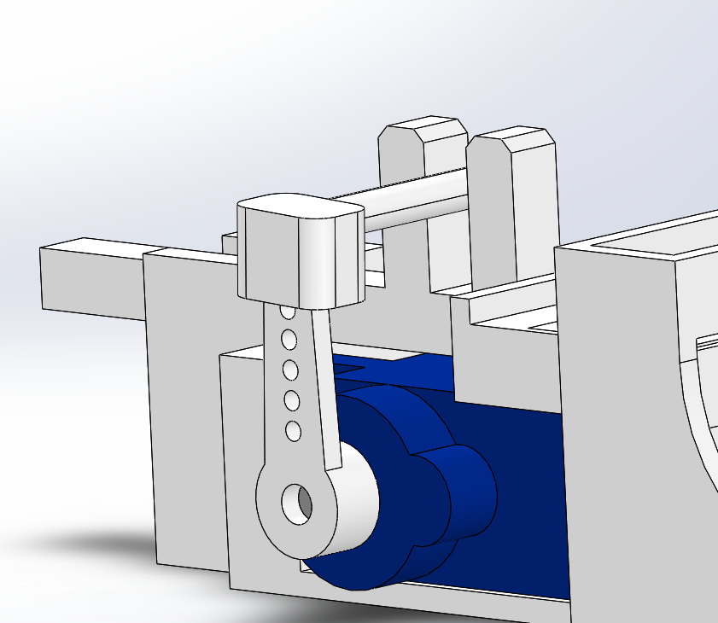
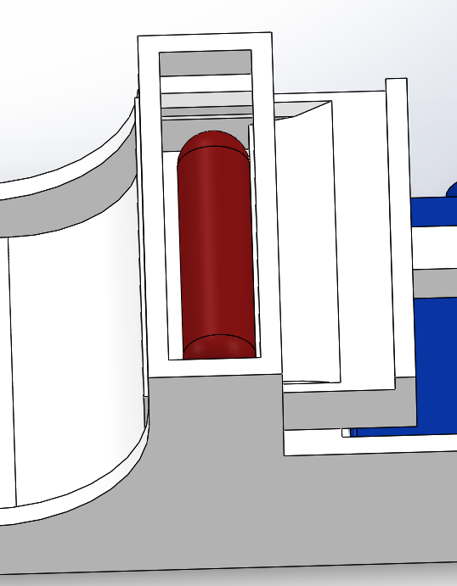
Improvements
Pusher Rod is press fit, should be permanently attached
Only works with one type and size of pill
Timing is hard coded, user interface would be useful
Magazine could be upgraded

Slide 34
Thank you for listening!

